Slide 1
Wikipedia @QUTLibrary
Kate Harbison (User:Harbison)
17/4/2018
CRICOS No. 00213J

Slide 2
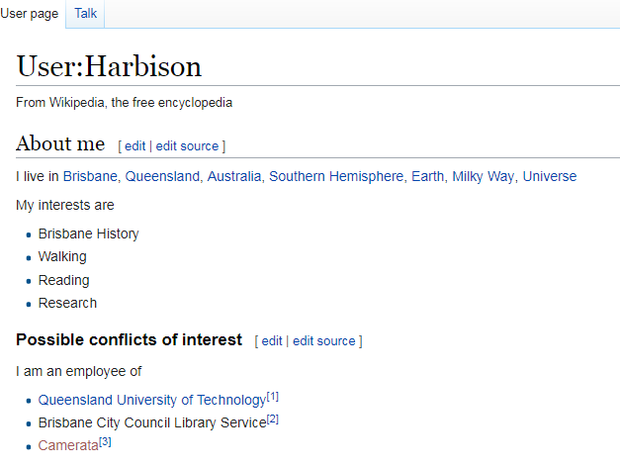

Slide 3
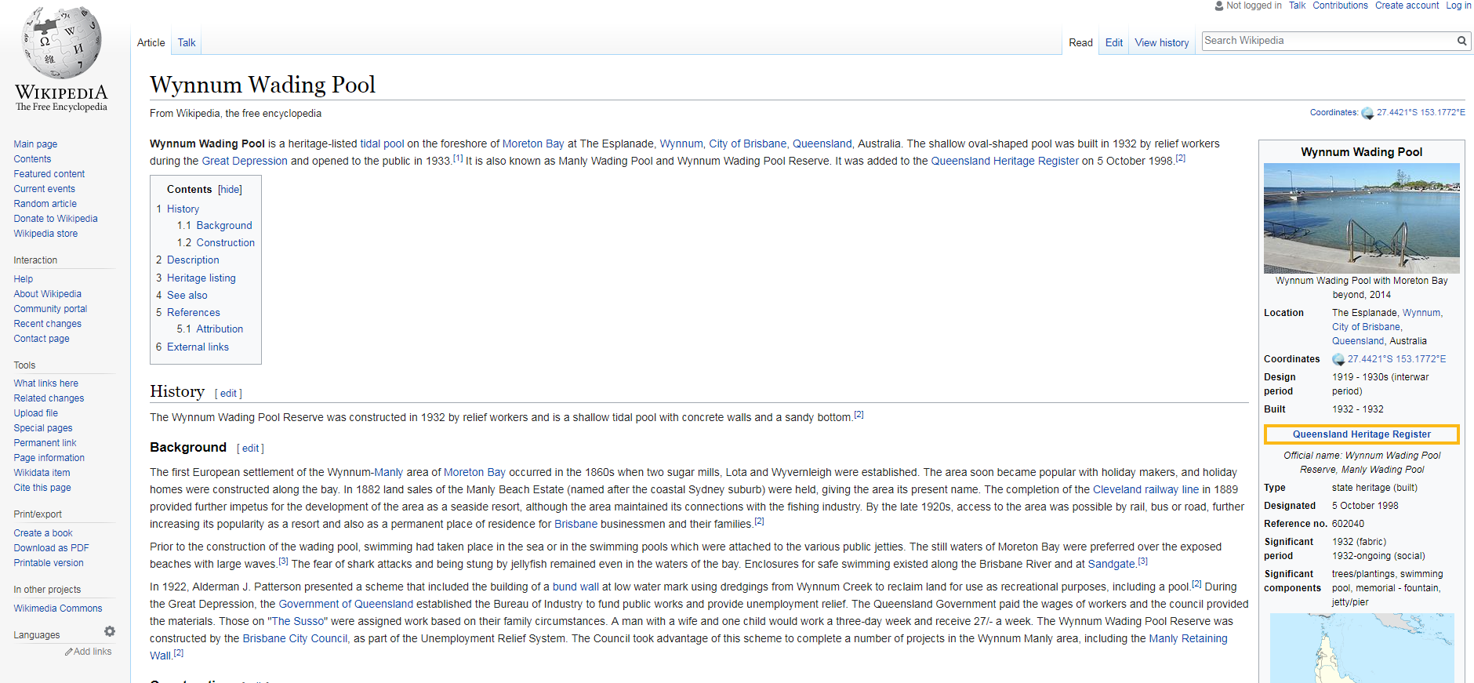

Slide 4
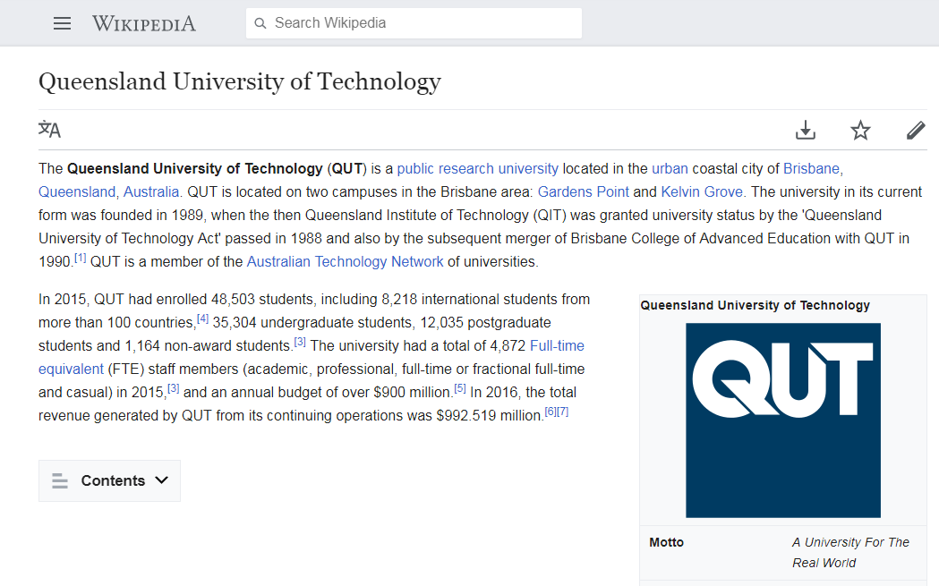

Slide 5
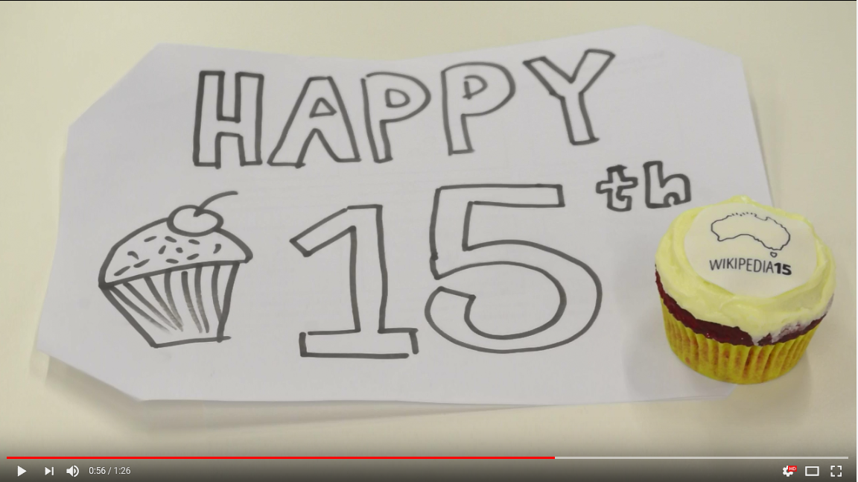
Notes:
https://www.youtube.com/watch?v=q7KcNkFy4uA

Slide 6
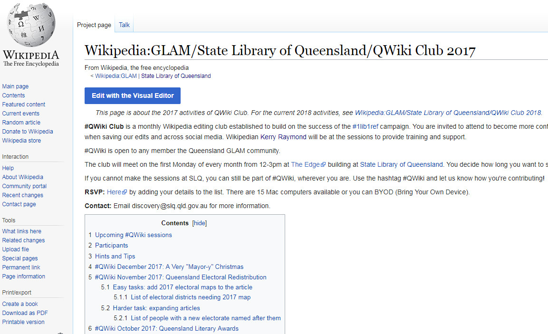
Notes:
Wikipedia:GLAM/State Library of Queensland/QWiki Club 2017
https://en.wikipedia.org/wiki/Wikipedia:GLAM/State_Library_of_Queensland/QWiki_Club_2017
March 2017

Slide 7
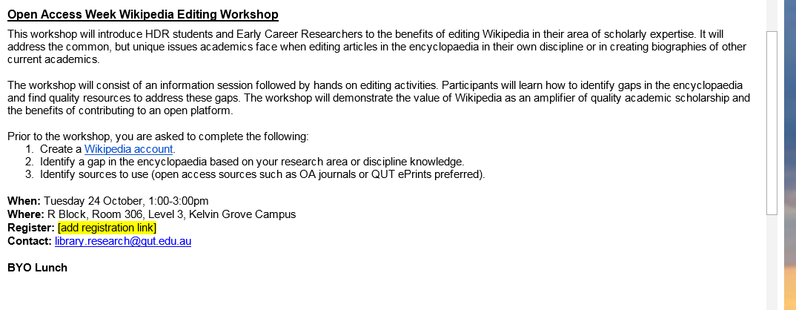

Slide 8
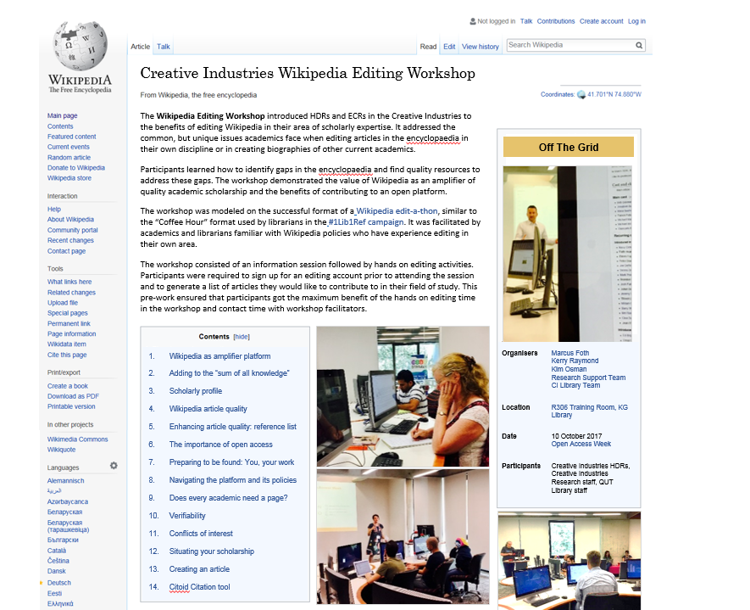
Notes:
The Creative Industries Wikipedia Editing Workshop introduced HDRs and ECRs in the Creative Industries to the benefits of editing Wikipedia in their area of scholarly expertise. It addressed the common, but unique issues academics face when editing articles in the encyclopaedia in their own discipline or in creating biographies of other current academics.
Participants learned how to identify gaps in the encyclopaedia and find quality resources to address these gaps. The workshop demonstrated the value of Wikipedia as an amplifier of quality academic scholarship and the benefits of contributing to an open platform.
The workshop was modeled on the successful format of a Wikipedia edit-a-thon, similar to the “Coffee Hour” format used by librarians in the #1Lib1Ref campaign. It was facilitated by academics and librarians familiar with Wikipedia policies who have experience editing in their own area.
The workshop consisted of an information session followed by hands on editing activities. Participants were required to sign up for an editing account prior to attending the session and to generate a list of articles they would like to contribute to in their field of study. This pre-work ensured that participants got the maximum benefit of the hands on editing time in the workshop and contact time with workshop facilitators.
Workshop program
Wikipedia as amplifier platform
Adding to the “sum of all knowledge”
Scholarly profile
Wikipedia article quality
Enhancing article quality: reference list
The importance of open access
Preparing to be found: You, your work
Navigating the platform and its policies
Does every academic need a page?
Verifiability
Conflicts of interest
Situating your scholarship
Creating an article
Citoid Citation tool
Organisers
Marcus Foth
Kerry Raymond
Kim Osman
Research Support Team
CI Library Team
Location
R306 Training Room, KG Library
Date
10 October 2017
Open Access Week
Participants
Creative Industries HDRs, Creative Industries Research staff, QUT Library staff

Slide 9
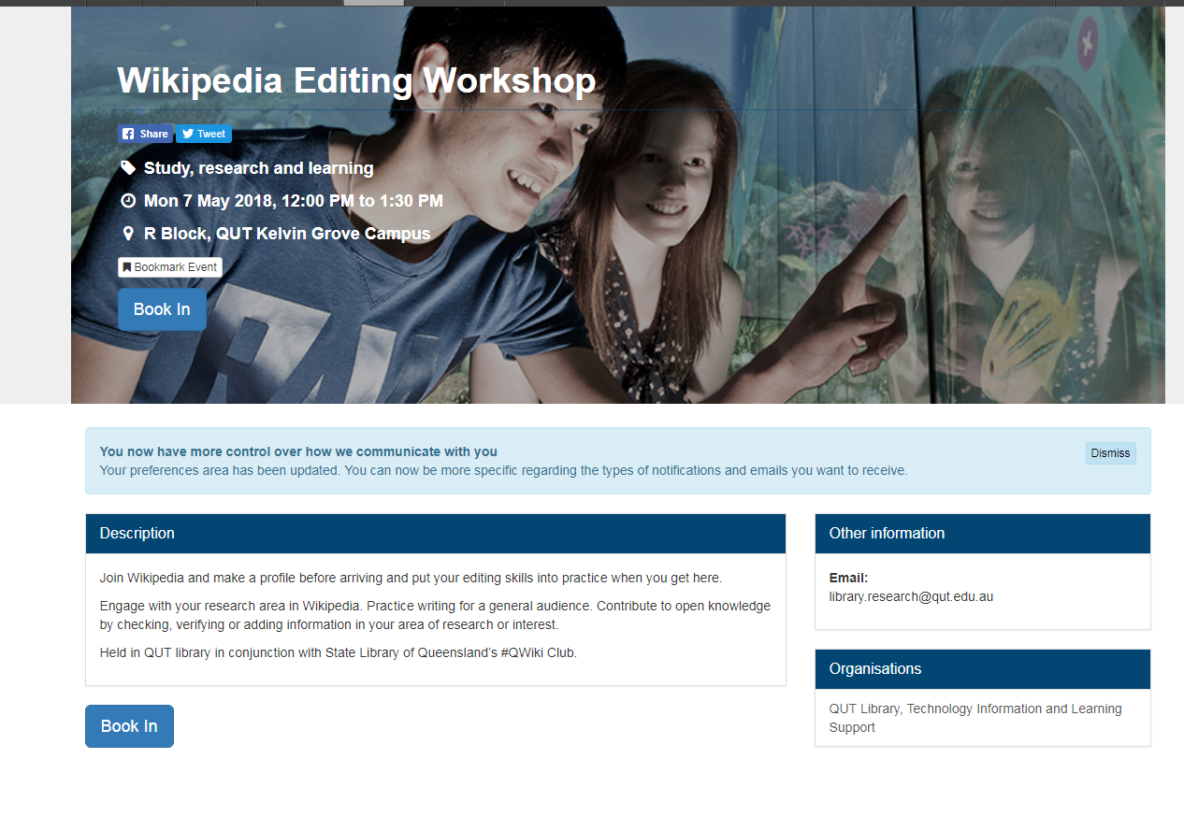

Slide 10
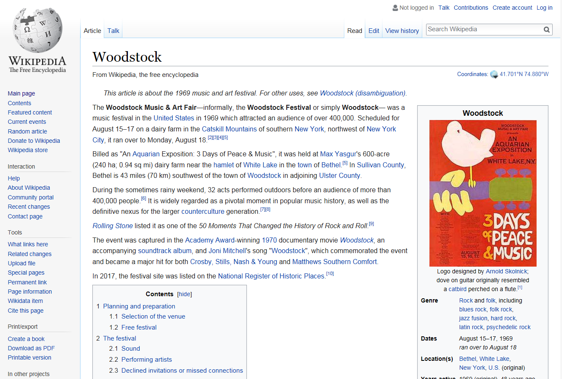
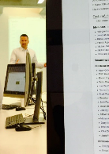
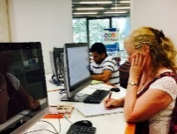
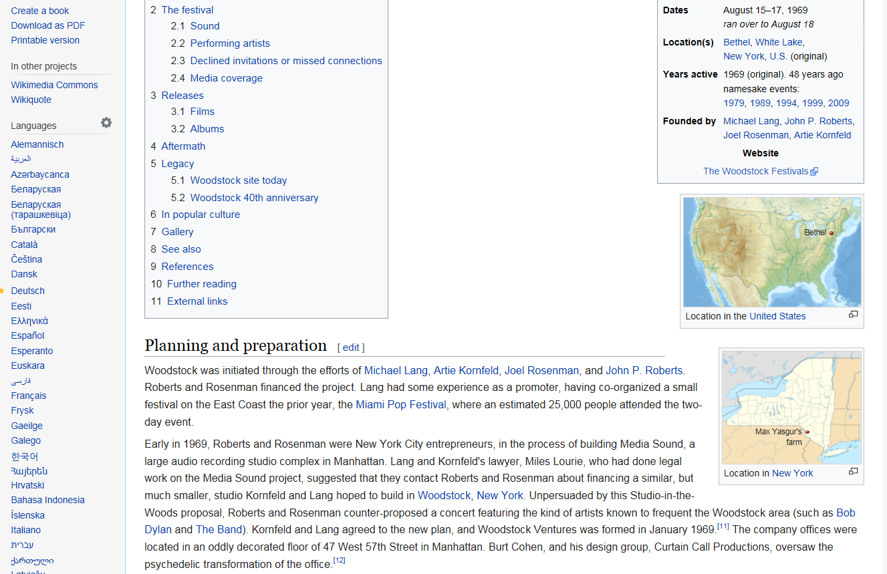
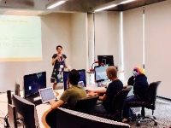
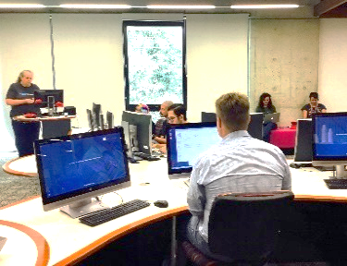
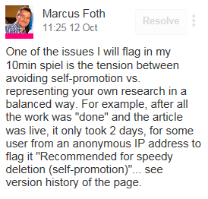
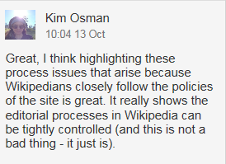
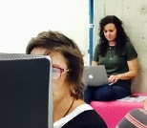
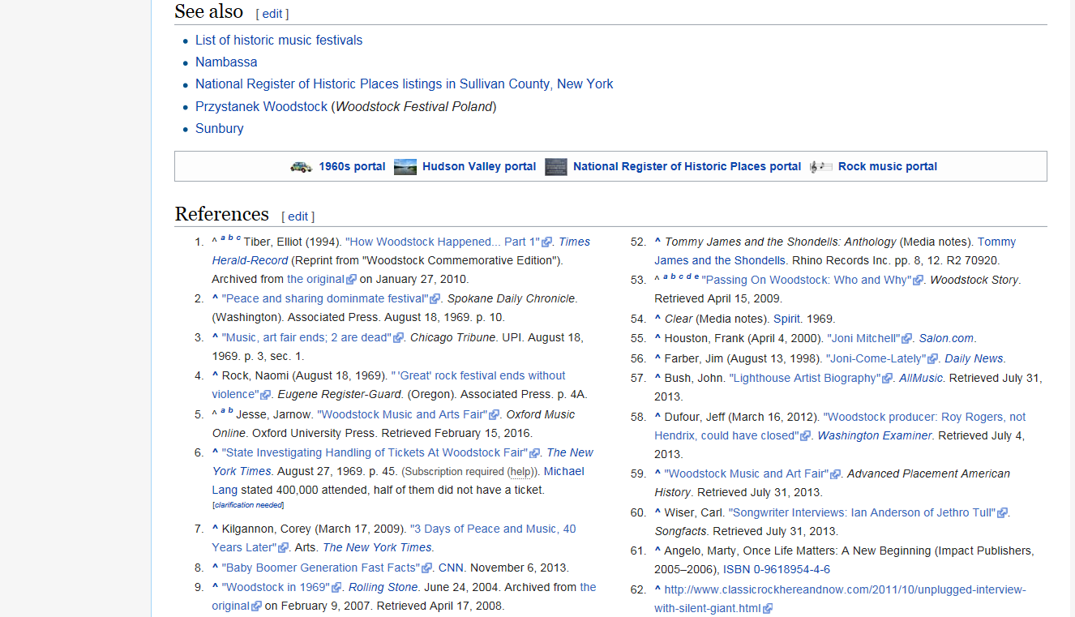
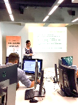
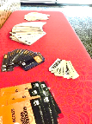
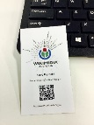
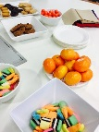
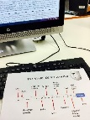
Creative Industries Wikipedia Editing Workshop
The Wikipedia Editing Workshop introduced HDRs and ECRs in the Creative Industries to the benefits of editing Wikipedia in their area of scholarly expertise. It addressed the common, but unique issues academics face when editing articles in the encyclopaedia in their own discipline or in creating biographies of other current academics.
Participants learned how to identify gaps in the encyclopaedia and find quality resources to address these gaps. The workshop demonstrated the value of Wikipedia as an amplifier of quality academic scholarship and the benefits of contributing to an open platform.
The workshop was modeled on the successful format of a Wikipedia edit-a-thon, similar to the “Coffee Hour” format used by librarians in the #1Lib1Ref campaign. It was facilitated by academics and librarians familiar with Wikipedia policies who have experience editing in their own area.
The workshop consisted of an information session followed by hands on editing activities. Participants were required to sign up for an editing account prior to attending the session and to generate a list of articles they would like to contribute to in their field of study. This pre-work ensured that participants got the maximum benefit of the hands on editing time in the workshop and contact time with workshop facilitators.
Off The Grid
Wikipedia as amplifier platform
Adding to the “sum of all knowledge”
Scholarly profile
Wikipedia article quality
Enhancing article quality: reference list
The importance of open access
Preparing to be found: You, your work
Navigating the platform and its policies
Does every academic need a page?
Verifiability
Conflicts of interest
Situating your scholarship
Creating an article
Citoid Citation tool
Organisers | Marcus Foth Kerry Raymond Kim Osman Research Support Team CI Library Team
Location | R306 Training Room, KG Library
Date | 10 October 2017 Open Access Week
Participants | Creative Industries HDRs, Creative Industries Research staff, QUT Library staff
Pre-work
Create a Wikipedia Account
Identify a gap in the encyclopaedia [based on your research areas/discipline knowledge] or an incomplete article or article light on for references
Identify sources to use:
  Open sources/open access journals
  QUT Eprints
Images from https://en.wikipedia.org

