Slide 1
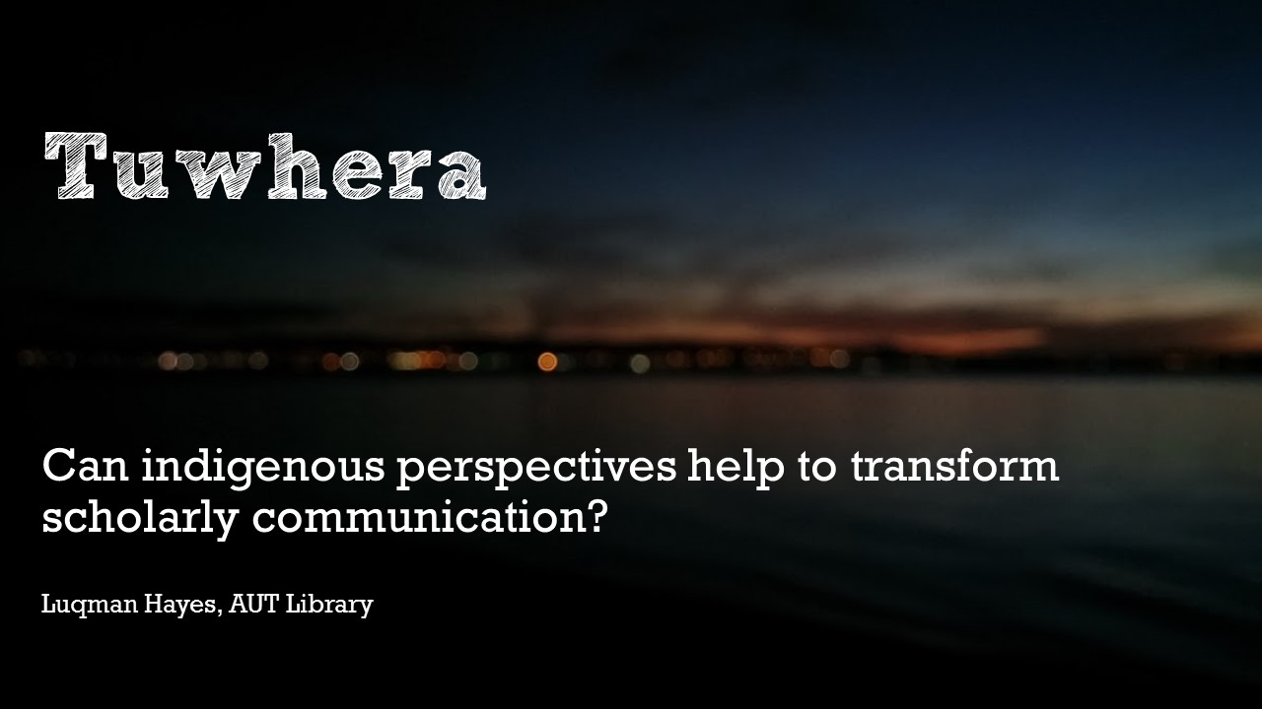
Notes:
Tēnā koutou katoa.
Nō Tamaki Makaurau ahau.
He Kaitiaki Pukapuka au kei te Te Wānanga o Aronui o Tāmaki Makaurau.
Ko Luqman Hayes tōku ingoa.
Ka nui te mihi ki a koutou katoa.
Nō reira, tēnā koutou, tēnā koutou, tēnā tātou katoa.
Translate and introduce yourself and where you come from & maybe where you are

Slide 2
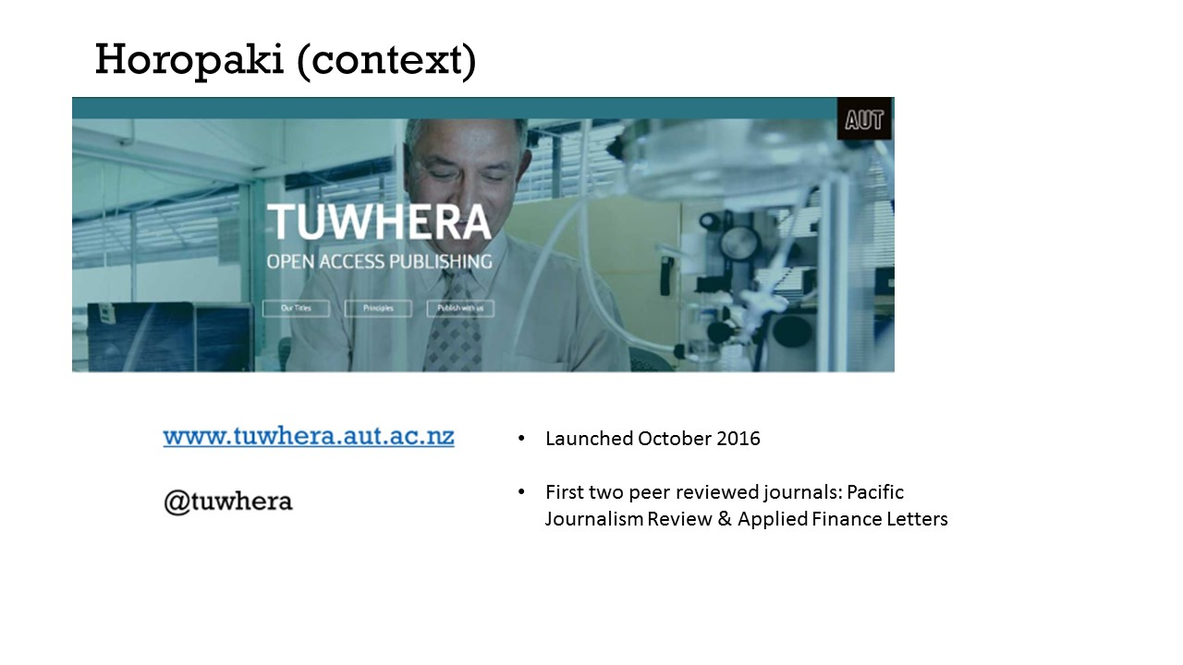
Notes:
Tuwhera is currently an open access journal hosting service at AUT. On the surface the story is quite straightforward. But it is also a story of change and growth, the kind of change that is iterative and evolutionary and has inspired alternative ways of looking at the work that we do, the environment in which we’re working and the kind of ethos what we want to strive towards.
As we have gone along, Tuwhera has developed kind of wairua (spirit) of its own and enabled us to consider academia, scholarly communication, ourselves as a library and as a team through arguably less-westernised lenses, such as through the reference to and acknowledging of indigenous knowledge paradigms.
In this talk I will discuss how we got set up and where we have got to and in telling that story I hope to be able to draw out the deeper learnings and how they might be useful as a counterpoint to our rather hierarchical, individualised attitude to knowledge.
So, launched in…starting with…
using Open Journal Systems – an open source platform developed by the Public Knowledge Project. Many will be familiar with OJS. Used by 1000s of Universities globally
Eg.s in NZ – Otago, VUW…

Slide 3
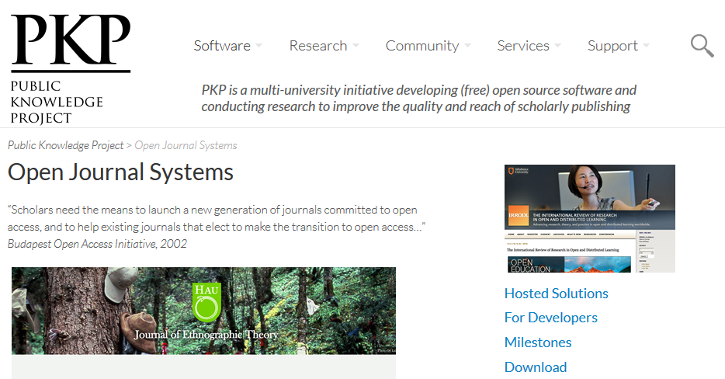

Slide 4
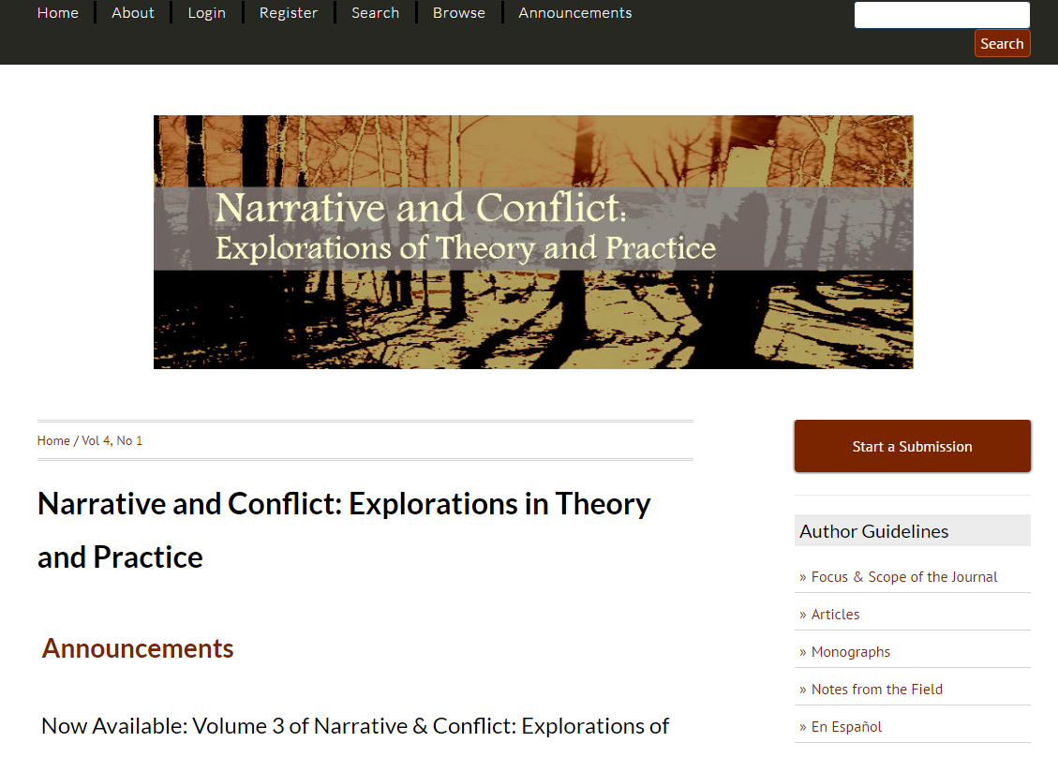
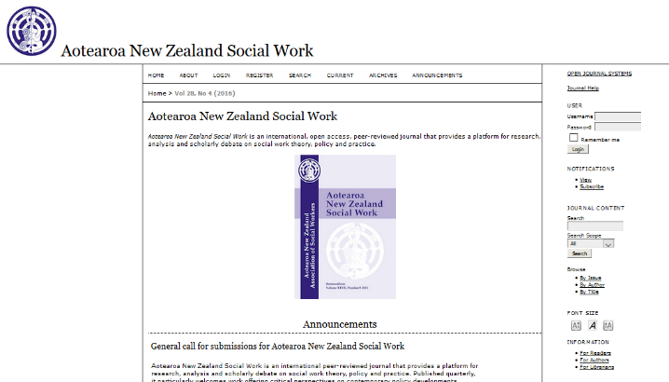

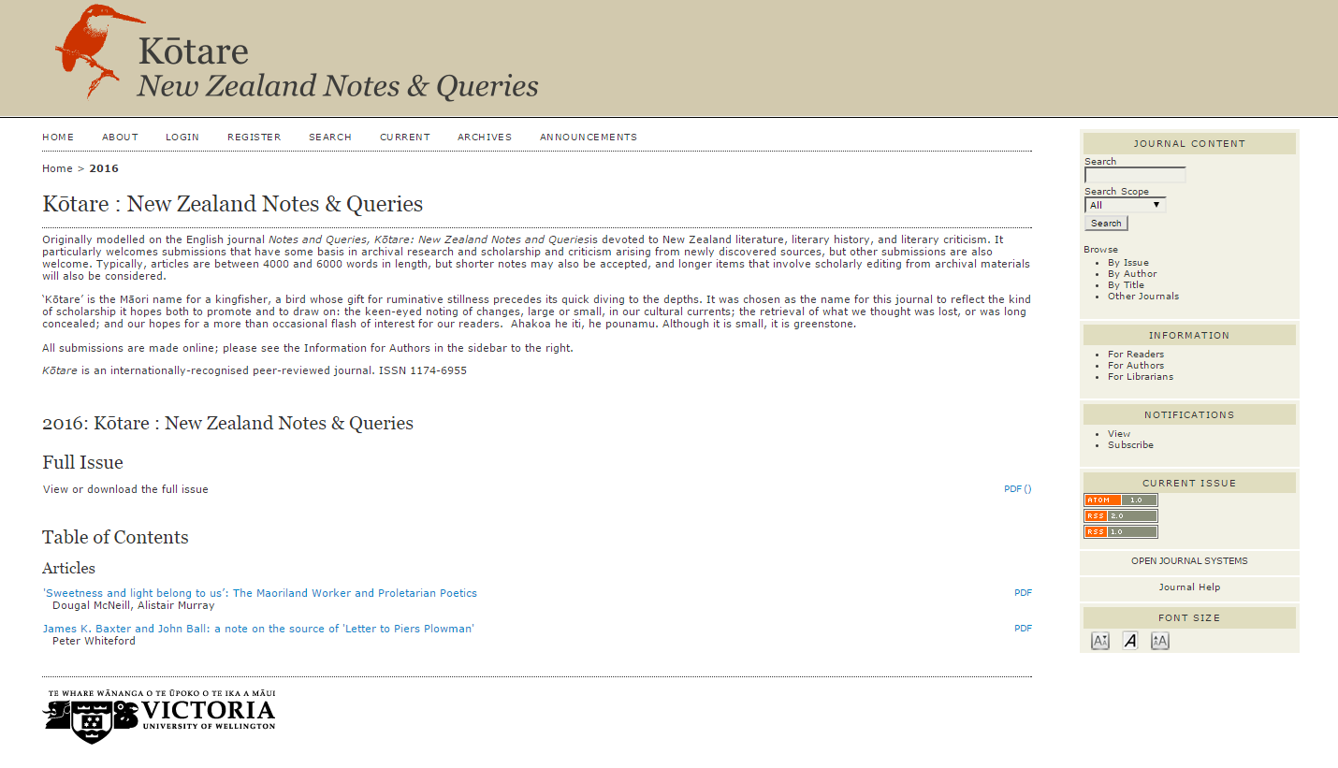
Notes:
Those who are familiar will know that until the launch of its recent version 3 after years of development, the standard journal site themes which OJS offers leave a lot to be desired from a user perspective.
But through research we found dedicated people out there who had done more with OJS and they made their work freely available for others to use or adapt. And so we did – MPG

Slide 5


Notes:
In terms of the individual journal sites themselves it’s useful to look at them in terms of some of the benefits of open access. This is Applied Finance Letters – which went from being a print journal with a list of static pdfs on a website to opening up its scholarship to a global audience.

Slide 6

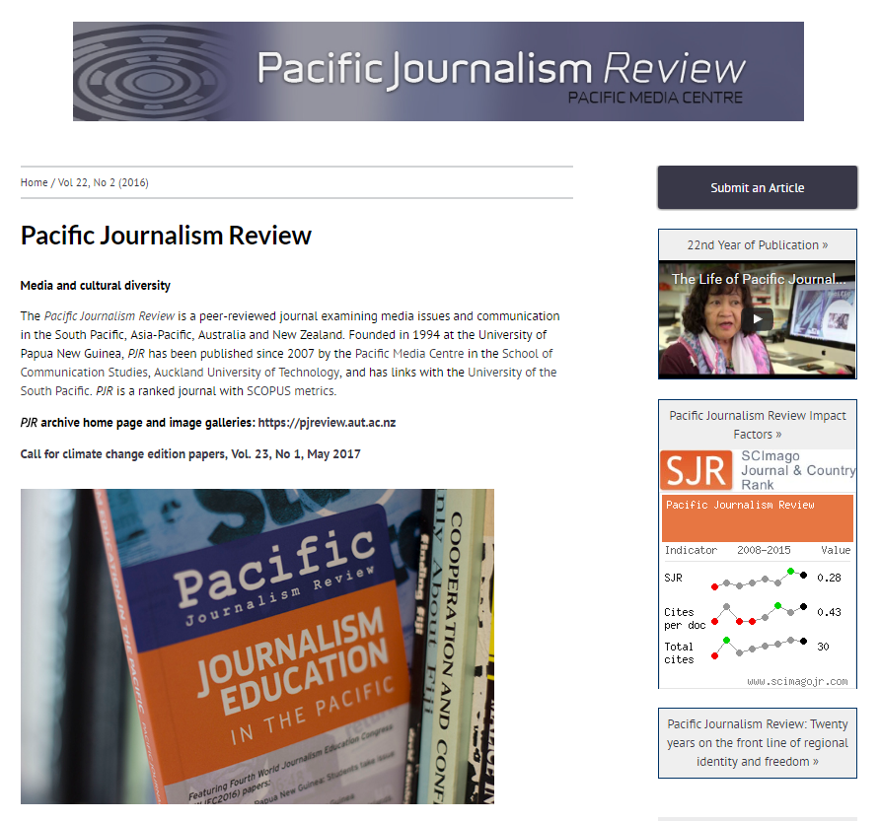
Notes:
But what about discourse in parts of the world with poor access to research. PJR produces content which explores a range of issues affecting many of the less developed regions of the southern hemisphere…

Slide 7
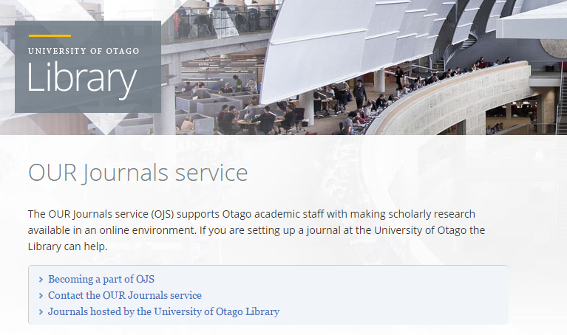
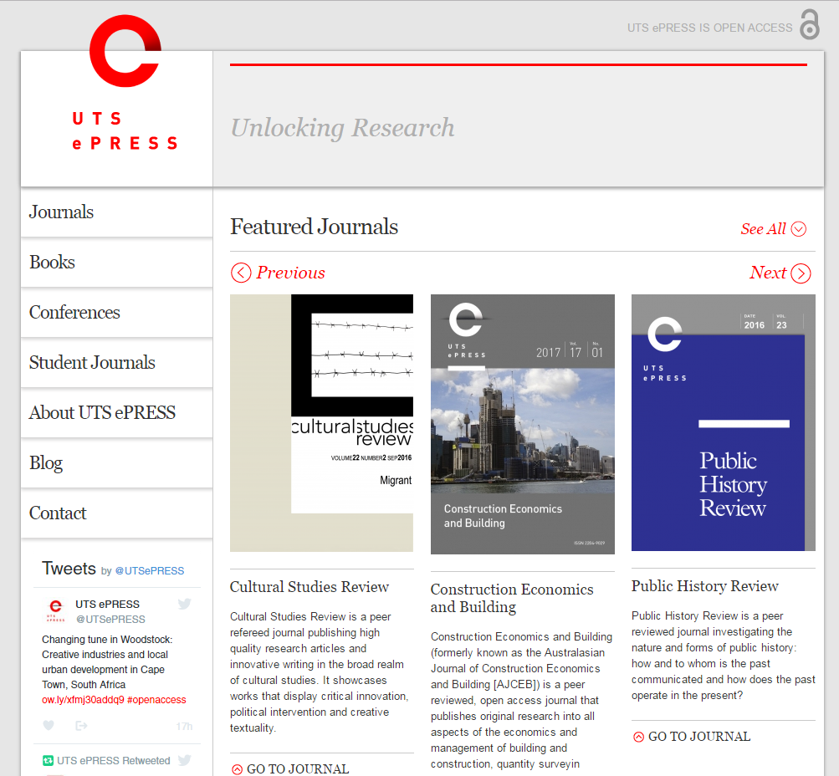
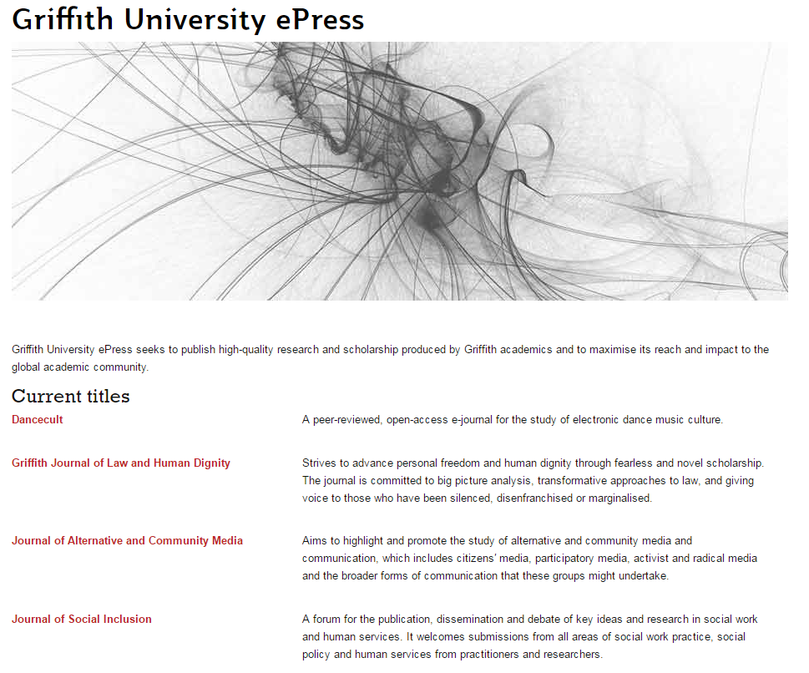
Notes:
In addition we wanted a shop front for our journals. It would have been tempting, given the resource constraints of our team, to create a simple page of links to our journals and bury it somewhere on the library website but we were forming a unique identity and we wanted something which reflected that.

Slide 8
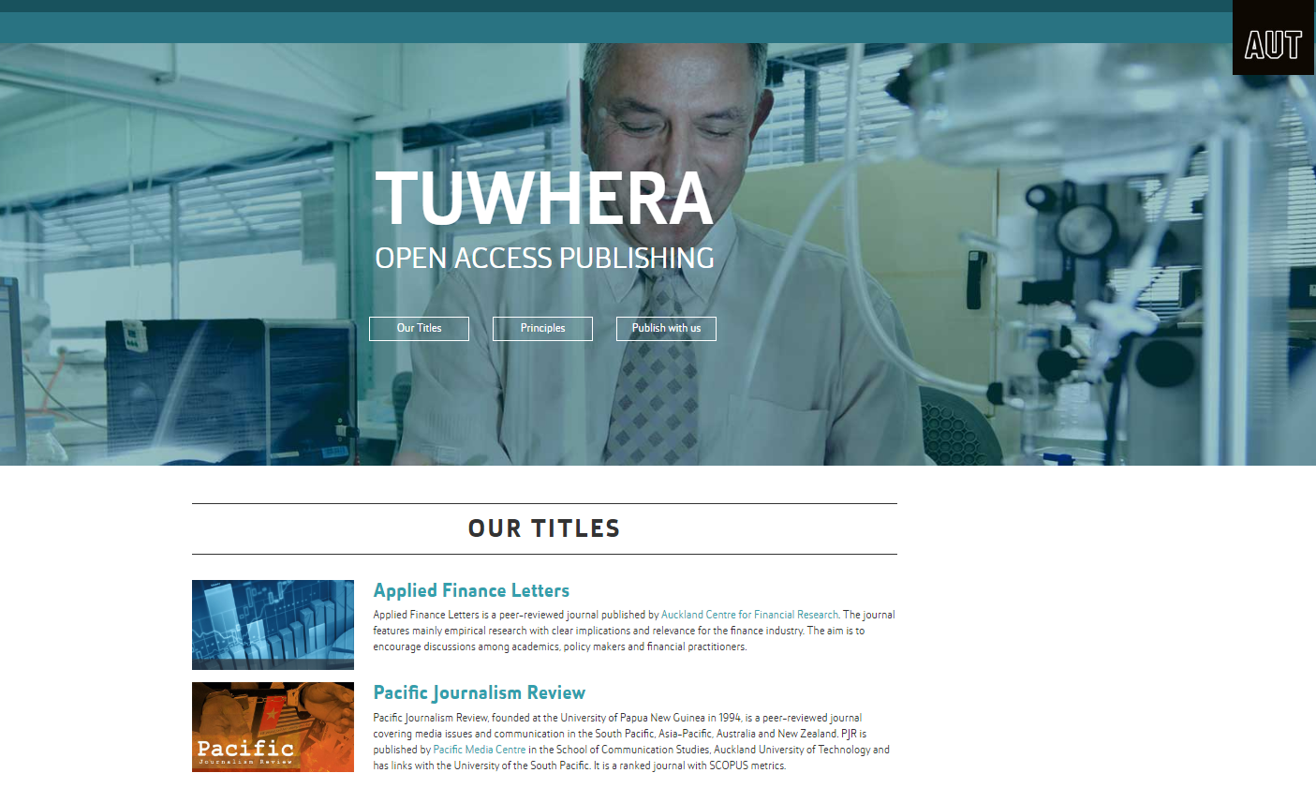
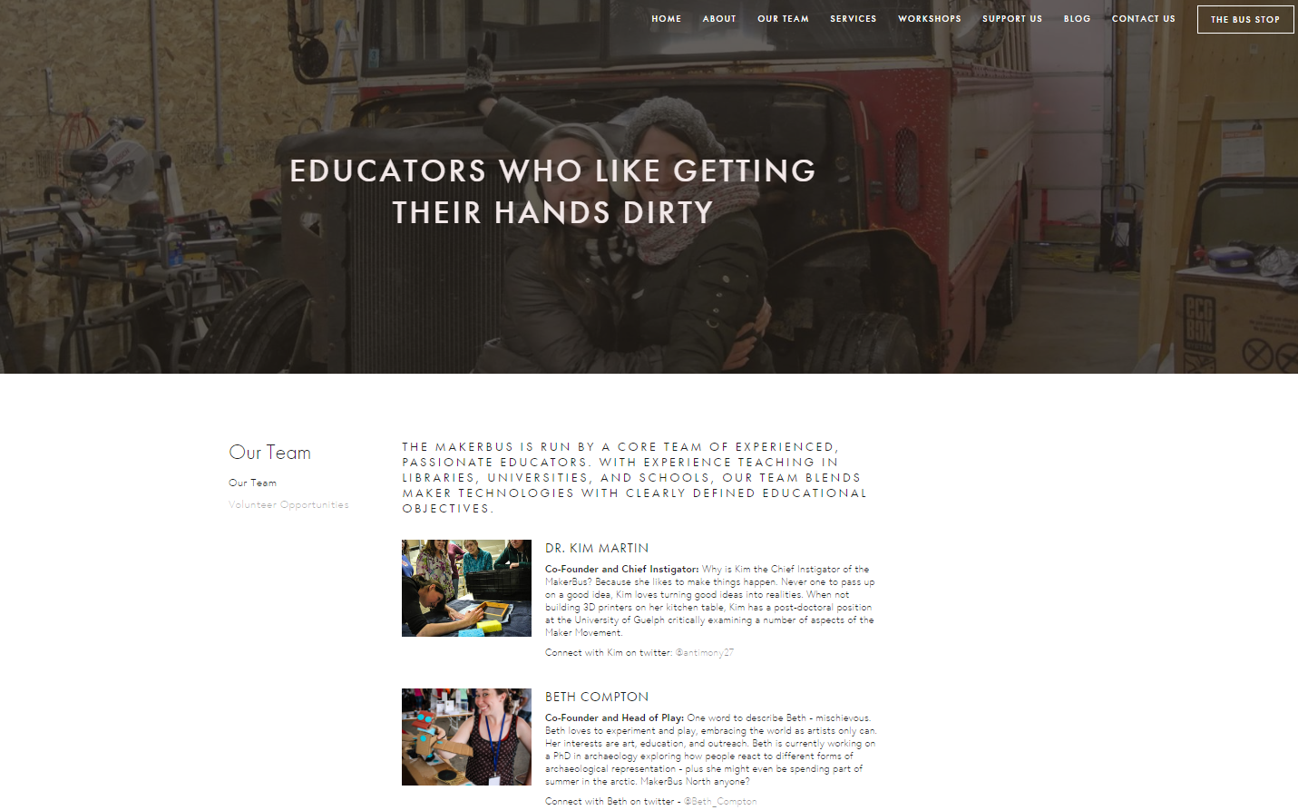
Notes:
Makerbus = Tuwhera
We looked at other landing pages but we wanted ours to reflect that open concept and so we took inspiration from clean, well designed sites which seemed to resonate with similar values…and of course that core concept: openness
Around this time we reflected on a name for the service and it struck us that leading with a Māori name might be a small way to acknowledge or honour te tiriti (Treaty of Waitangi), also that it would be potentially more inclusive in a bicultural sense as well as being uniquely Oceanian. The word Tuwhera seemed to fit well, and to encompass that concept which lay at the heart of what we wanted to do with AUT-edited scholarship.
We consulted with Māori members of academic staff, in particular Dr Valance Smith and when we launched the service we did so with a strong Maori flavour, karakia, waiata

Slide 9
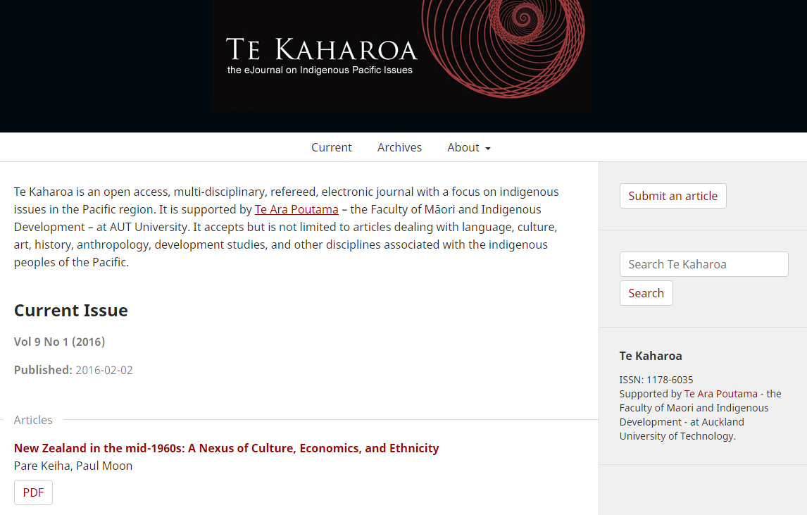
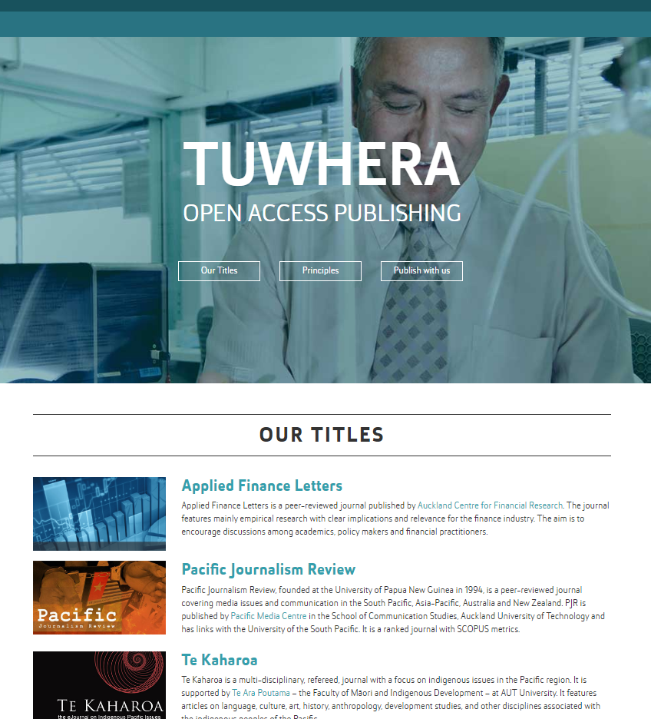
Notes:
This year we added three more titles to our collection; each using OJS 3. TK launched in April. Again, this is not the typical OJS theme, this design was inspired by work done by, these people…

Slide 10
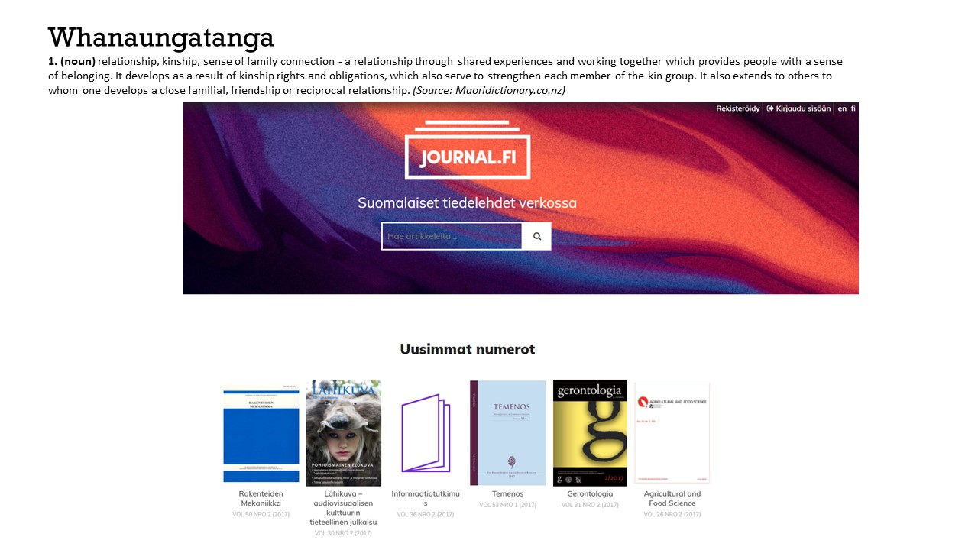
Notes:
Inspiration (and code) for our latest OJS 3 sites – Finnish Science Journals online. Details here: https://pkp.sfu.ca/2017/02/14/announcing-a-new-ojs-3-theme-and-expanded-theming-documentation/
We might consider the open source community in terms of whanaunatanga (whanau = family)

Slide 11
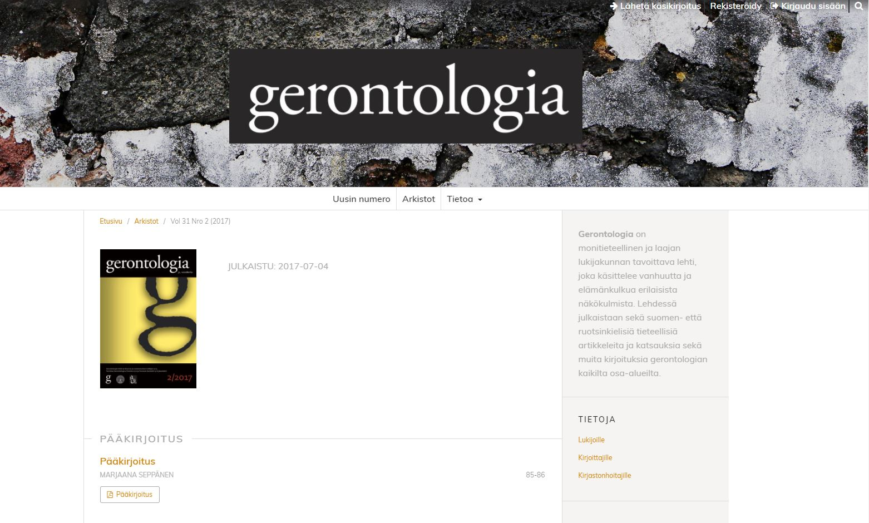
Notes:
From this…

Slide 12


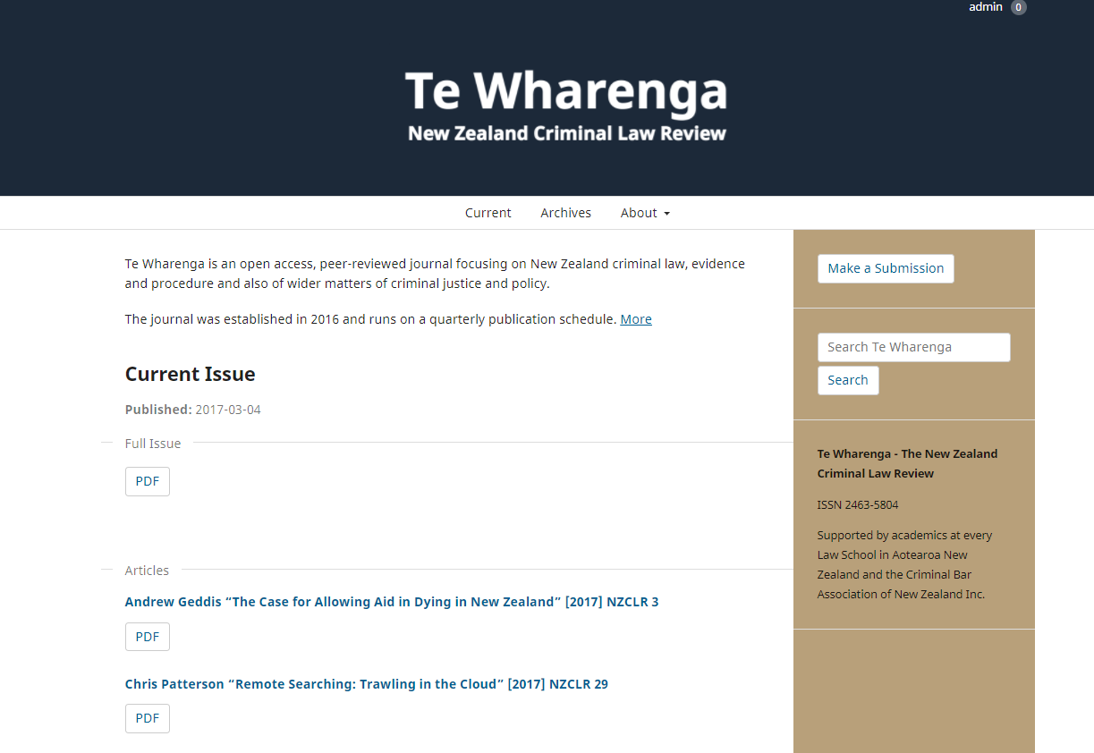
Notes:
Te Wharenga and Pacific Health in July. The platform has taken on a very Pacific feel, particularly with journals leading with Maori titles. PJR has now added a Maori name – Te Koakoa (muttonbird)
Conversation which stems back to an OA Week panel discussion in 2016 has lead to the emergence of new publications types coming to the fold which highlight new and emerging research. Lead to thinking of Tuwhera as creating a kind of incubator space, guiding and advising fledging publications, alongside the more established, wiser cousins, as it were.
Some of this might be targeted at practitioners in the community and in industry, others offers unique research content which is not being published elsewhere but which hasn’t necessarily followed the traditional academic publishing route of peer reviewed….the key point is there is a desire to communicate research with the wider community not just within the confines of the academy
What has drawn this interest is the acknowledgement that sharing research in this way has clear and tangible benefits for the researchers involved, the potential for attracting future funding and collaboration

Slide 13
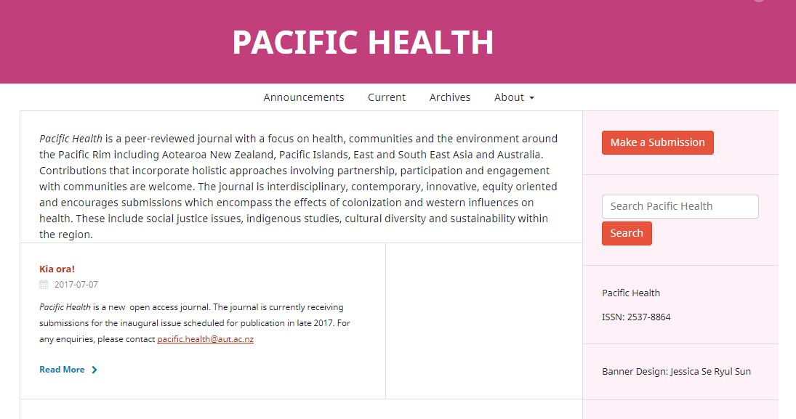

Notes:
Pacific Health is a brand new peer reviewed journal while HI is the first of our lay summary publications.
Working with the editors of both titles can be seen as awhinatia and manaakitanga in action. In doing so our relationship with our researchers has taken on a reciprocal feeling – HI for instance have offered treat…

Slide 14
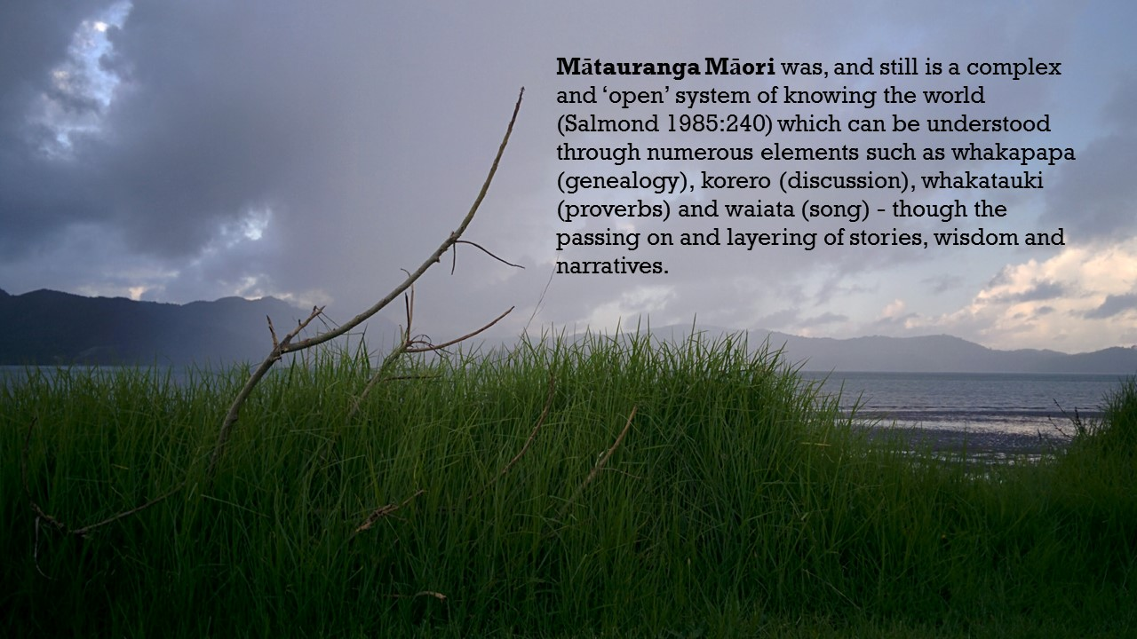
Notes:
A lot of the thinking around the influence of Māori concepts and values stemmed from that word Tuwhera. I think there is significance in the fact that the word (like many in the Māori language) has multiple interpretations and contexts. It signifies an opening up of ideas and possibilities…
As a wider team this has impacted on how we think about and carry out our work, in terms of shared values, such as Ubuntu (I am because we are; a person is a person through other people) which has similarities to the Māori concept of mana tangata- to be a person is not to stand alone but to be one with one’s people (empowerment).
Might such a philosophical reassessment of the largely meritocratic, individualistic values and motivations which currently drive academic output (and its assessment) help to shape a sustainable, culturally relevant, holistic and communitarian scholarly communication landscape?
Mandy Henk and Nerida Quatermass in their webinar talked about the role of power in the systems which we operate in and I would add to that that we need to reconsider the knowledge economy (as it has become) in terms of colonialism as well as capitalism. Our understanding of knowledge creation, growth and dissemination is dominated by institutions and corporations which are motivated by profit. These are an extension of the plundering methods of knowledge and culture accumulation of their imperial predecessors.
Consider Mātauranga Māori (definition) and now consider how we share knowledge that we contribute to – knowledge, after all, doesn’t reside with the individual – who are we really doing this for – ourselves or society?
In the blog I referred to Chris Cormack’s talk on Marae-based consensus building where whakatauki are a source of better understanding and informing collaborative approaches to learning. These and others have the potential to be transformational if we are willing to consider a more collectivist, community-based worldview. As things stand the mentality and the structure of the system in which we work are antithetical to this – so ultimately, this is a political as well as a philosophical question.
Some of the values and concepts that we as a team have adopted have made their way into our Library’s strategic document. One outcome we are hopeful for is that our University responds to the calls we are making and the initiatives we are championing around open access and develops a robust policy to match.
Our thinking now is that Tuwhera encompasses openness at AUT, therefore it represents an umbrella, or the overarching vision and can incorporate a range and diversity of knowledge sets.

Slide 15
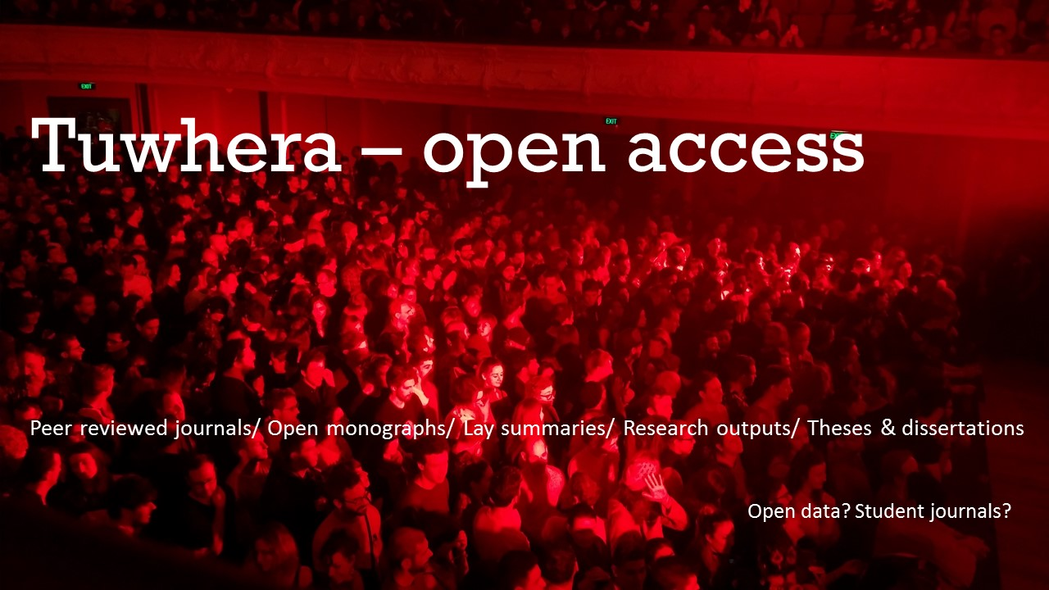
Notes:
When we relaunch Tuwhera in October (that’s the aim) we hope to bring all of our open collections under the one whare (house) – statement that knowledge is a communication, a reciprocal korero (conversation) with our communities in the spirit of ako (learning & teaching).

Slide 16
