Slide 1
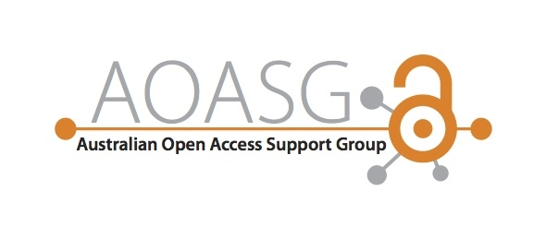

Slide 2
Funder OA Policies & Requirements
Paula Callan
Scholarly Communications Librarian
QUT Library, QUT
p.callan@qut.edu.au
Catherine New
Coordinator, Research Services
University Library, Curtin University
c.new@curtin.edu.au
Notes:
In this session today I am going to outline some of the history, and recent developments in OA policies from an international perspective. Paula will then look at the Australian-specific context, and how you can comply with the mandates.

Slide 3

Defining Open Access
Full-text is available online without password or payment
Barriers to access are removed
Notes:
In the area of peer reviewed research publications, open access simply means that a version of the full-text is available online without password or payment being required for access. The term open access describes the nature of access, rather than a specific business model, licence or type of content.
Under the traditional publishing model journal publishers charge readers to access the content of the journal. This might be as pay per view, where a single article can be read, generally costing in the vicinity of $30-$40 per article. It may also be in the form of journal subscriptions, which can vary enormously in price. The most expensive journal subscription I was able to locate was the Journal of Comparative Neurology; 24 issues per year at a cost of USD $30000 pa, $36000 for online and print.

Slide 4

Budapest OA Initiative 2002
“An old tradition and a new technology have converged to make possible an unprecedented public good… The public good they make possible is the world-wide electronic distribution of the peer-reviewed journal literature and completely free and unrestricted access to it by all scientists, scholars, teachers, students, and other curious minds”.
http://www.budapestopenaccessinitiative.org/read
Notes:
The Budapest Open Access Initiative is a public statement of principles relating to open access to research literature. It arose from a meeting by the Open Society Foundation in December 2001 and has risen to somewhat of a landmark of the OA movement. The statement includes one of the most commonly used definitions of open access and it also nicely captures what the open access movement is seeking to achieve:
The old tradition referred to is the willingness of scientists and scholars to publish the fruits of their research in scholarly journals without payment, for the sake of inquiry and knowledge. The new technology is the internet.
The public good is that anyone and everyone can access peer reviewed journal literature. A key driver for open access is the notion of public access to publicly funded money.
The Budapest statement goes on to say:
Removing access barriers to this literature will accelerate research, enrich education, share the learning of the rich with the poor and the poor with the rich, make this literature as useful as it can be, and lay the foundation for uniting humanity in a common intellectual conversation and quest for knowledge".

Slide 5

First Funder OA Policy
Max Planck Society (2003)
  Publish according to principles of open access
  Repository-delivered OA
    “A complete version of the work... is deposited... in at least one online repository... to enable open access, unrestricted distribution, [OAI] interoperability, and long-term archiving.” http://openaccess.mpg.de/policy
Notes:
Momentum for open access has been increasing rapidly over the last few years, with many funding agencies and governments introducing OA mandates. However, it is not just a recent development.
Over a decade ago in October 2003 the Max Planck Society called on their grant recipients to publish their work according to the principles of open access. They included repository-delivered OA in their definition of open access.

Slide 6











Other Funder Open Access Policies
90 funding bodies around the world now have open access mandates
Notes:
Over the last decade numerous funding bodies have introduced open access mandates or policies, requiring that funded research be made available open access. As momentum builds it is highly likely that more funding agencies and governments will introduce similar mandates.
Paula will discuss later the nuances between different policies and their requirements of authors. However it is clear that these policies have impacted both on publishers’ and authors’ behaviour.
For example the NIH policy introduced in 2008 requires all investigators funded by the NIH submit to PubMed Central an electronic version of their final, peer-reviewed manuscript at time of acceptable, to be made publically available no later than 12 months from official data of publication. While many publishers have embargo periods longer than 12 months, the sheer number of articles funded by the NIH means that journal publishers cannot ignore the policy and risk losing those articles. As a result, some publishers will even send an author’s final peer-reviewed manuscript to PubMed Central to enable authors to comply. This demonstrates the change that policies can create.
The HEFCE (Higher Education Funding Council for England) policy, introduced in May 2013, is likely to have a major impact on the behaviour of researchers in the UK. The policy states that, to be eligible for submission to the post-2014 REF (Research Excellence Framework – research assessment exercise similar to the ERA), authors’ final peer-reviewed manuscripts must have been deposited in an institutional or subject repository on acceptance for publication. The policy applies to research outputs accepted for publication after 1 April 2016, but they strongly urge institutions to start implementation now. In many ways this is stronger than a straight mandate, or at least more powerful, in that it incentivises authors to put their publications into a repository if they want them to ‘count’.

Slide 7
Recent Developments
Indian Department of Biotechnology and the Department of Science and Technology (July 2014)
Chinese Academy of Science (May 2014)
Natural Sciences and Engineering Research Council of Canada (October 2013)
European Commission – Horizon 2020
Notes:
Other examples of national funding agencies and governments that have introduced open access policies, or draft policies for consultation in the last 12 months include the Indian Department of Biotechnology and the Department of Science and Technology, the Chinese Academy of Science and the Natural Sciences and Engineering Research Council of Canada’s three funding agencies. The Mexican, Argentine and Italian governments have introduced policies, and work is also being undertaken by the Danish and Swedish governments, to name a few.
Most of these policies require that make papers open access by publishing in an open access journal or, posting the final accepted manuscript to an online repository, within 12 months of publication. In most instances these policies give preference to the green, or self-archiving model. The draft policy from the Indian Department of Biotechnology and the Department of Science and Technology states clearly the will not underwrite article processing charges levied by some journals. It will be interesting to see if this remains in the final version of the policy, or if pressure from publishers will see this statement removed such that authors can use funds to cover APCs, as they can elsewhere.
The European Commission’s Horizon 2020 has introduced a pilot on Open Research Data for the 2014-2015 Work Programme. This includes the data and associated metadata, needed to validate the results presented in scientific publications as soon as possible, and other data as specified and within the deadlines laid down in the data management plan.

Slide 8

Recent developments
Societal advancement is made possible through widespread and barrier-free access to cutting-edge research and knowledge, enabling researchers, scholars, clinicians, policy-makers, private sector and not-for-profit organizations and the public to use and build on this knowledge
http://english.cas.cn/Ne/CASE/201405/P020140516548023313654.pdf
Notes:
The language that forms part of these policies and the rationale behind open access, between agencies and nations seems very consistent. The two common themes are:
The research arises from public funds and therefore it is important that the information and knowledge generated be made publically available
Global science will be advanced more speedily through broadest dissemination of knowledge
This is a direct quotation from the Chinese academy of sciences, where it suggests that open access allows all people, from varying areas, often left without access to information under the traditional model, to benefit and build on this knowledge.

Slide 9
Recent developments
International Council for Science
  Free of financial barriers for any researcher to contribute to;
  Free of financial barriers for any user to access immediately on publication;
  Made available without restriction on reuse for any purpose, subject to proper attribution;
  Quality-assured and published in a timely manner;
  Archived and made available in perpetuity.
  icsu.org/general-assembly/news/ICSU%20Report%20on%20Open%20Access.pdf
Notes:
At their 2014 General Assembly the International Council for Science voted to endorse a statement on open access. The following is an excerpt and you can see that it is quite strongly worded, calling for immediate access and available for reuse for any purpose. This is the optimal form of open access, but Paula will go into more detail later on the different kinds of open access shortly.
From the first paragraph, they made it clear that the goals apply both to the peer-reviewed research publications, the data on which the results and conclusions of the research are based, and any software or code used in the course of the research.
This is part of an emerging trend to broaden the debate by extending open access expectations to the data behind the research publications.

Slide 10
Data Sharing Mandates
NIH | “data sharing statement” required for proposals requesting > $500K
NASA | Data sharing policy (also maintains its own data repository)
NOAA | Data sharing requirement (via national data centres)
AHA | Publicly share data required for independent verification w/in 12 months (rationale required for opt-out)
USDA | All funded research data to be submitted into the public domain without restriction.
Wellcome Trust | Funded researchers should maximise access to their research data with as few restrictions as possible.
EU | Proposals for Horizon 2020 funding must show how the data will be exploited and/or shared/made accessible for verification and re-use
Notes:
In the US and Europe, a number of funding agencies have already included data management and data sharing obligations into their funding rules. This slide provides some examples.
To quote from the NASA data and information policy:
The greater the availability of the data, the more quickly and effectively the user communities can utilize the information to address basic Earth science questions and provide the basis for developing innovative practical applications to benefit the general public.
Replace ‘Earth Sciences’ with any other subject area and the same would apply. Sharing data also reduces duplication; it means people don’t have to keep reinventing the wheel, so to speak, and can instead build on the most up-to-date research.
National Institute of Health
National Aueronautics and Space Administration
National Oceanic and Atmospheric Administration
American Heart Association
US Department of Agriculture

Slide 11
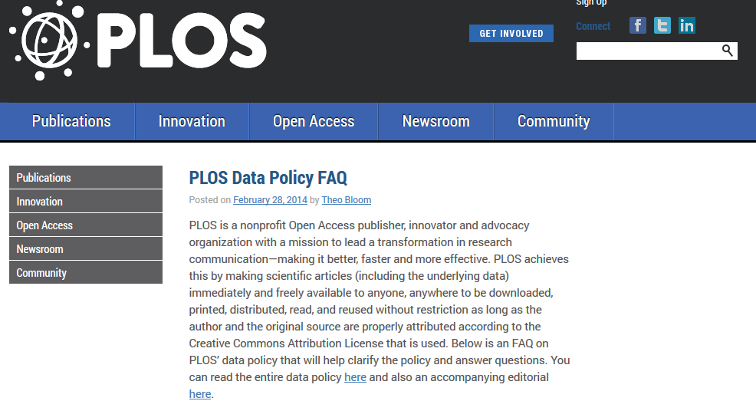
Data sharing mandates
Notes:
Some publishers, like PLOS are requiring authors to make the underlying data from an article to be made freely available for researchers to use, unless there are legal or ethic reasons preventing this.
BioMed Central has a similar policy. Some BioMed Central journals now additionally encourage or require authors, as a condition of publication, to include in some article types a section that provides a permanent link to the data supporting the results reported in the article.
It is a condition of publication in both Science and Nature journals that authors make available to any reader the materials, data and associated protocols promptly available to others without undue qualifications. Any restrictions on the availability of materials or information must be disclosed to the editors at the time of submission. Any restrictions must also be disclosed in the submitted manuscript, including details of how readers can obtain materials and information. While they may not specifically mean it must be published in an openly accessible repository, there are certainly movements towards this.

Slide 12
Repositories for Research Data
Data Hub is a data management hub used by Nature http://datahub.io/group/npg
Dryad offers journal integration services to link journal article publication with data deposit http://datadryad.org/
Figshare provides data hosting for publishers http://figshare.com/services/publishers
Genbank http://www.ncbi.nlm.nih.gov/genbank
Notes:
In order to comply with these policies on sharing data, one option is to deposit into a research data repository.
Data Hub is a data management hub used by Nature. Other examples that care acceptable repositories include Dryad or Figshare.
Some disciplines, such as genomics, have their own data repository and have well developed standards and etiquette.
Citation databases like Thomson Reuters Data Citation Index now provide the capability of tracking citation to data, which may make it more likely authors will be more open and willing to share their data.

Slide 13
Data Journals
Scientific Data
Geoscience Data Journal
Earth System Science Data
Journal of Open Archaeology Journal
Journal of Chemical and Engineering Data
For more data journals, see: http://proj.badc.rl.ac.uk/preparde/blog/DataJournalsList
For more information about data journals see:
http://ands.org.au/guides/data-journals.html
Notes:
Another option is to publish data into a data journal. Data journals provide an opportunity for researchers to gain credit for publishing their research data in a more formal, peer-reviewed context.
Some data journals require researchers to deposit the dataset in a data repository and publish the description, location and licensing terms. Other data journals also host a copy of the actual dataset.
Scientific data is a Nature publication. It primarily publishes Data Descriptors, a new type of scientific publication designed to promote an in-depth understanding of research datasets. Data descriptors include detailed descriptions of the methods used to collect the data and technical analyses supporting the quality of the measurements. They generally do not include analysis of the data itself.
I would now like to hand over to Paula who is going to go into more detail on the Australian OA policies and mandates.

Slide 14


Australian oa policies & mandates
http://aoasg.org.au/
Notes:
Hello everyone.
I’m Paula Callan. I am the Scholarly Communications Librarian at QUT Library in Queensland and I will be covering the section on Funder mandates here in Australia

Slide 15

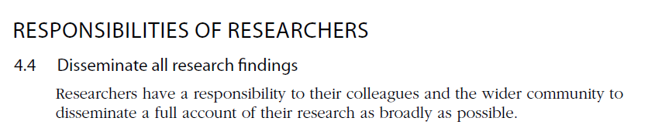
Australian Code for the Responsible Conduct of Research
https://www.nhmrc.gov.au/_files_nhmrc/publications/attachments/r39.pdf
Notes:
While it is not technically a policy or mandate, the Australian Code for the Responsible Conduct of Research clearly spells out the responsibility of institutions and researchers to disseminate research findings to their colleagues and the wider community.
The Code is, in effect, a position statement on open access as research findings NOT made open access are generally not available to the wider community.
The Code also spells out the responsibilities of researchers and their institutions in relation to the management of research data.

Slide 16
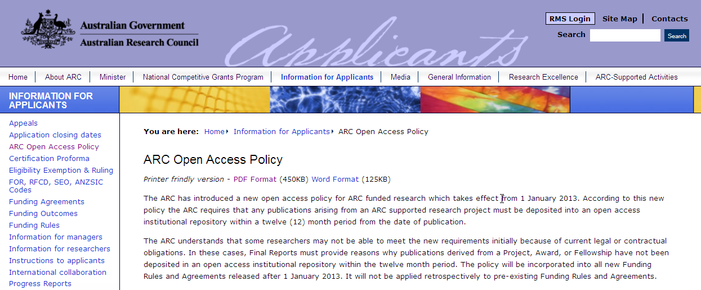
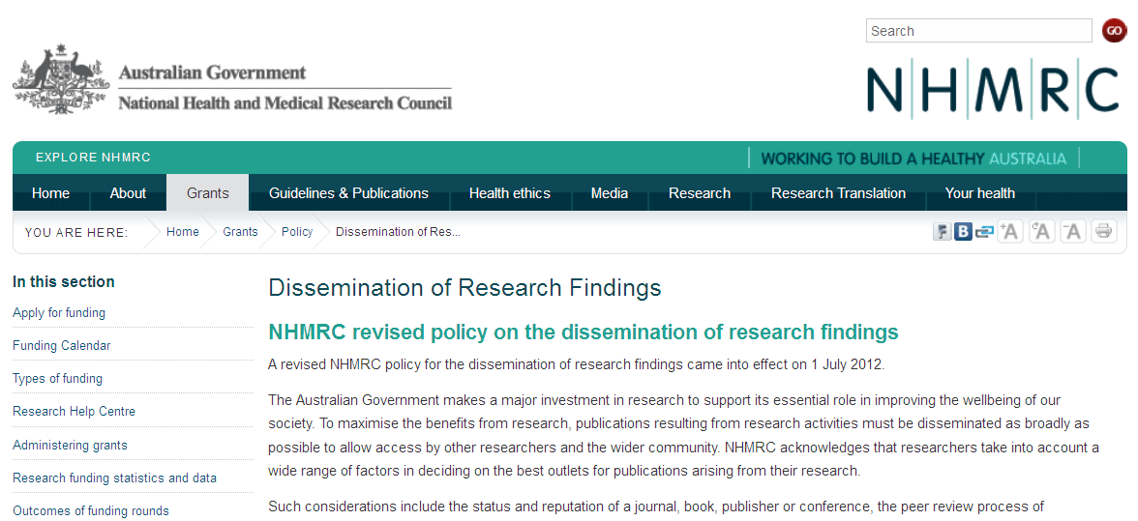
ARC and NHMRC Open Access Policies
http://www.nhmrc.gov.au/grants/policy/dissemination-research-findings
http://www.arc.gov.au/applicants/open_access.htm
Notes:
The two main research funding agencies in Australia, the Australian Research Council and the National Health & Medical Research Council have both implemented open access policies.
The policy details are available from their websites and, importantly, they have been incorporated into their current ‘Funding Rules’ documents.

Slide 17
Rationale for ARC and NHMRC Policies
To maximise the benefits from research, publications resulting from research activities must be disseminated as broadly as possible to allow access by other researchers and the wider community.
Notes:
This is the rationale given by the ARC and the NHMRC for adopting an open access policy:
“To maximise the benefits from research, publications resulting from research activities must be disseminated as broadly as possible to allow access by other researchers and the wider community.”
This aligns with the Government’s stated reason for investing in research, which is to support its role in improving the wellbeing of our society.
I will now outline some of the key features of both policies.

Slide 18
NHMRC: Policy on the Dissemination of Research Findings
Introduced in July 2012
Requires that any publication arising from NHMRC supported research must be deposited into an open access institutional repository within a twelve month period from the date of publication.
http://www.nhmrc.gov.au/grants/policy/dissemination-research-findings
Notes:
The NHMRC policy was introduced in July 2012 .
The policy requires that:
Any publication arising from NHMRC supported research must be deposited into an open access institutional repository within a twelve month period from the date of publication.
The policy applies to journal publications accepted for publication after July 2012, regardless of the date of the grant.

Slide 19
ARC: Open access policy
Introduced in January 2013
requires that any publications arising from an ARC supported research project must be deposited into an open access institutional repository within a twelve (12) month period from the date of publication.
http://www.arc.gov.au/applicants/open_access.htm
Notes:
The ARC policy was introduced in 2013
The wording of the policy is identical but it applies to:
Publications arising from grants awarded after 1st January
Applies to all publication formats – journal articles, conference papers, books and book chapters

Slide 20
Both policies include an obligation to…
Acknowledge the grant (Grant ID) on publications.
Submit publication details (including grant ID) to an institutional repository as soon as possible after the paper is accepted.
Submit full-text manuscript to the repository as soon as possible after the publication date.
Ensure that an open access version of the paper is available within 12 months of the publication date or as soon as possible after that date.
Declare in the Final Report whether or not an open access is available.
http://aoasg.org.au/resources/comparison-of-arc-nhmrc-policies/
Notes:
The actual obligations of both policies are identical:
The grant , including the grant ID must be acknowledged on the publication.
The publication details, i.e., the metadata, must be submitted to an institutional repository as soon as possible after the paper is accepted. This must include grant ID.
The authors accepted manuscript version must be submitted to the repository as soon as possible after the publication date. However, it need not be openly accessible at this stage if an embargo is required.
An open access version of the paper must be available within 12 months of the publication date or as soon as possible after that date. This can be the author’s accepted manuscript version or the published version.
If an open access copy will never be available, then this must be declared in the Final Report and a reason given.

Slide 21


The policies apply to publications fully or partially funded by ARC or NHMRC grants
Notes:
The policies apply to partially funded research too.

Slide 22

The open access options
Doors in Valetta, Malta By Julien Lozelli
Notes:
To comply with the mandates there are two options available to researchers.
These are commonly referred to as ‘Green’ open access and ‘Gold’ open access.
As far as the ARC and NHMRC are concerned, both options are acceptable so it is up to the funded researchers to choose which option best suits their particular circumstances.

Slide 23
Gold Open Access
Publisher provides open access published version via journal website
Includes articles published in fully open access journals and hybrid journals
May require payment – article processing charge
Portion of grant can be spent on publication costs
Notes:
Gold open access is where an open access copy of the published version is immediately freely available from the journal website. Gold open access is provided by the publisher.
It includes fully open access journals, where the entire contents of the journal is freely available online immediately on publication. Some, but not all, fully open access journals charge authors a fee to cover the publishing costs. For commercial publishers and scholarly society journals, this fee is in lieu of the subscription revenue they are forgoing. Open access journals published universities are often free for both readers and authors. This is only possible where the host institution is prepared to subsidise the operating costs of the journal.
Gold open access also includes hybrid journals which are subscription journals that provide an option for the individual article to be made open access via the journal website on payment of a fee. Hybrid open access fees are generally higher than those charged by fully open access journals.
In most cases, when an article processing fee has been paid, the author can upload the published version of the article to an institutional repository or personal web page. However, the terms of the publishing agreement need to be read to confirm this. Where this is not possible, the repository can hold the publication metadata plus a link to the open access full-text on the journal website.

Slide 24
Green Open Access
Authors provide an open access copy of their ‘Accepted Manuscript’ version by depositing it in a repository.
An embargo period may be required before the article is open access
No fee or payment required
Notes:
Green open access is provided by authors when they deposit a copy of the ‘accepted manuscript’ version in a repository.
Generally, the article will have been accepted for publication in a subscription journal and copyright will have been assigned to the publisher. Many publishing agreements now specify that the author retains the right to post a copy of the accepted manuscript version on their personal website or institutional repository.
Green open access allows researchers to meet their obligation to provide an open access copy without having to divert part of their grant money to cover a publisher’s open access fee.

Slide 25
Gratis & Libre Open Access
Gratis OA
Libre OA
&
Notes:
More nuanced definitions of open access distinguish Gratis OA, which means absence of price barriers from Libre OA which means no price or permission barriers on re-use.
Green open access is ‘Gratis OA’ and, for the purpose of complying with the ARC and NHMRC policies, Gratis OA is sufficient.
Gold open access is sometimes, but not always, ‘Libre OA’ Generally, where the author has paid an open access fee, the article is published under a Creative Commons Licence.
The most liberal creative commons licence, CC-BY, enables articles to be re-used for any lawful purpose, including commercial re-use. However, some publishers are now charging higher fees for this licence.

Slide 26
Paying for Open Access
ARC and NHMRC both allow some of their grant to be directed to dissemination costs
For most ARC schemes, publication and dissemination of Project outputs and outreach activity costs are ‘supported budget costs’.
NHMRC rules state: ‘Publication costs cannot be requested on an application but may be listed as a legitimate cost against DRCs as part of the financial acquittal process.’
Notes:
Neither policy actually refers to payments for article processing charges.
However, both the ARC and the NHMRC do allow some of their grant allocation to be directed to publication costs:
For most ARC schemes, publication and dissemination of Project outputs and outreach activity costs are ‘supported budget costs’.
NHMRC rules state that: ‘Publication costs cannot be requested on an application but may be listed as a legitimate cost against Direct Research Costs as part of the financial acquittal process.’
However, funded researchers are often reluctant to use part of their grant to pay an article processing fee so it is fortunate that the ARC and NHMRC have made it very clear that Green OA is compliant.

Slide 27

Grant applications
ARC grant applications include a requirement to submit a plan for “communicating the research results to other researchers and the broader community”
http://www.arc.gov.au/word/DP15/DP15%20Instructions%20to%20Applicants.docx
Notes:
ARC grant applications include a requirement to submit a plan for “communicating the research results to other researchers and the broader community”
This is to encourage researchers to think about how they are going to comply with the open access requirement long before they get to the publishing stage.
And certainly before they get to the stage where they have signed a publishing agreement which is non-compliant.

Slide 28
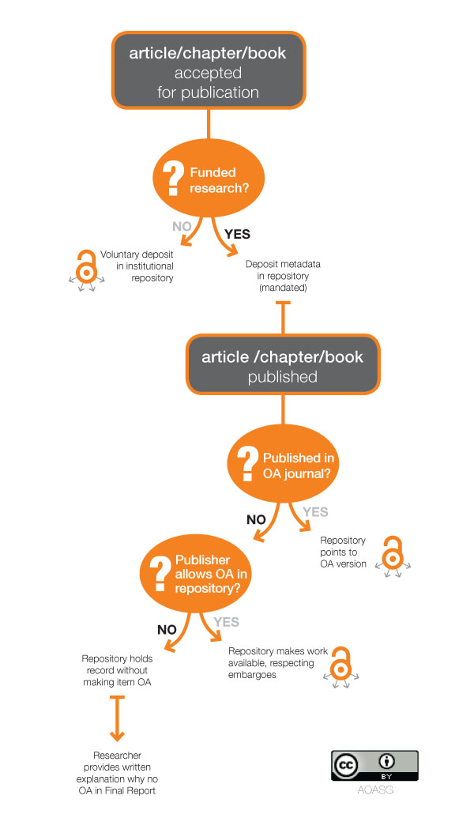
Compliance Decision Tree
http://aoasg.org.au/resources/policy-compliance-decision-tree/
Notes:
When a researcher has a grant, not all of their publications will be related to the grant.
This compliance decision tree is available from the AOASG website.
It can help researchers in receipt of an ARC or NHMRC grant understand their obligations and their options.

Slide 29

Guide to Tagging Institutional Repository Records Related to ARC/NHMRC Grants
http://www.caul.edu.au/caul-programs/research/repository-services
Notes:
On the Council of Australian University Librarians website, there is a Guide to Tagging Institutional Repository Records Related to ARC/NHMRC Grants.
This outlines the repository-related requirements set down by the ARC and NHMRC in relation to publication metadata and also suggests a few strategies which may help universities with the process of collecting the metadata.

Slide 30
Publisher policies on mandated OA
Elsevier
  Wants institutions and funders with OA mandates to sign a special agreement which would bind them to longer embargo periods for some journals (up to 48 months). ARC and NHMRC have not signed
Wiley
  ARC and NHMRC funded authors may self-archive the author accepted version of their paper (authors manuscript) after a 12-month embargo period from publication in an open access institutional repository
Notes:
Some of the large commercial publishers are keen to channel researchers, especially those with grants, towards their paid open access options. This includes their own OA journals (whose APCs tend to be more expensive that the APCs of non-profit publishers) and their even more expensive Hybrid OA option.
Evidence of this can be found in practices such as Elsevier asking funders and institutions with mandates to sign special agreements which would bind authors associated with their grants, or with the institution, to longer embargo periods – sometimes as long as 4 years.
The ARC and NHMRC have NOT signed an agreement with Elsevier. However, authors should check the terms of any publishing agreement they are asked to sign in case an extended Green open access embargo period has been specified. If it has, authors should look for another journal unless they are willing to use upwards of $3,000 of their grant money.
Wiley, on the other hand, allows authors to comply with the ARC and NHMRC mandates by depositing the accepted manuscript version in an institutional repository and it can be made open access after 12 months. This is a concession on their part as their default policy says that only the preprint version can be used.

Slide 31
Open Access to Research Data
ARC Discovery Projects (Funding Rules)
The ARC considers data management planning an important part of the responsible conduct of research and strongly encourages the depositing of data arising from a Project in an appropriate publically accessible subject and/or institutional repository
Notes:
The ARC funding rules strongly encourages the depositing of data arising from a Project in an appropriate publically accessible subject and/or institutional repository but it is not actually mandated by the ARC or the NHMRC at this stage.

Slide 32
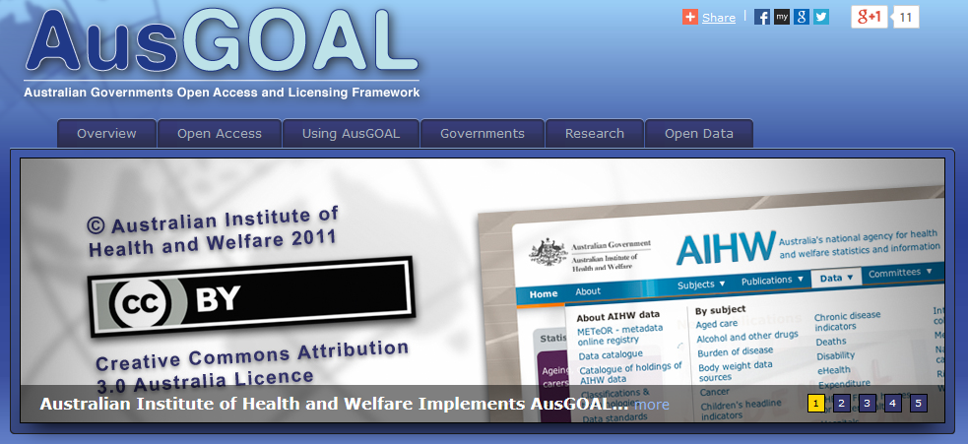
Government Data and Publications
Government information (data and publications) are made available under open content licences such as
http://www.ausgoal.gov.au/
Notes:
The Australian Government has made ‘open access’ the default for Government information. Government publications and data are made available under a range of open content licences including Creative Commons licences.
The choice of licence is guided by the AUSGOAL framework.

Slide 33
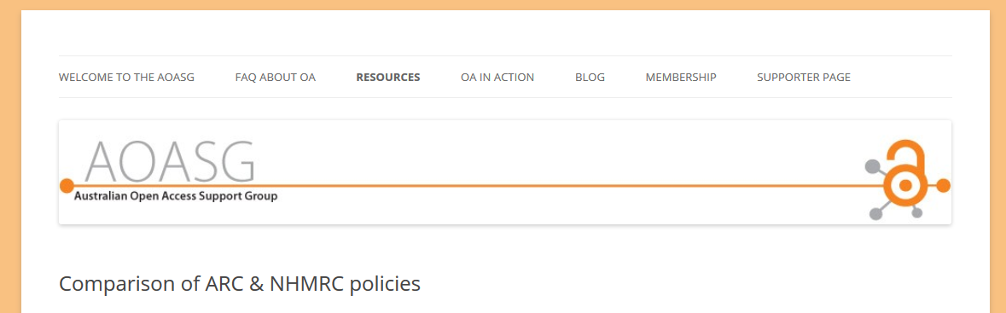
More information….
Available from the AOASG website
http://aoasg.org.au/resources/comparison-of-arc-nhmrc-policies/
Notes:
More information about the ARC and NHMRC policies, plus a range of resources that can help communicate the requirements and options, are available from the AOASG website.
I will now hand over to Susannah to

Slide 34
AOASG Member Institutions
Australian National University
Charles Sturt University
Curtin University
Griffith University
Macquarie University
University of Newcastle
Queensland University of Technology
University of Western Australia
Victoria University
The Patron of the AOASG is Emeritus Professor Tom Cochrane, Faculty of Law at QUT.
aoasg.org.au

