Slide 1
Welcome to the inaugural
Open Access Forum organised by AOASG

Slide 2
Housekeeping
Tweet: @openaccess_oz
Internet: eduroam
- use your institutional login

Slide 3
AOASG Members:
Roxanne Missingham, - Australian National University
Karen Johnson - Charles Sturt University
Catherine Clarke - Curtin University
Linda O’Brien - Griffith University
JoAnne Sparks - Macquarie University
Mark Sutherland - University of Newcastle
Judy Stokker - Queensland University of Technology
Kate Croker - University of Western Australia
Ralph Kiel - Victoria University

Slide 4
AGENDA
10:00 | Event opening remarks (Judy Stokker – AOASG chair)
10:10 | Dr Erin McKiernan – Culture Change in Academia
10:40 | Emeritus Professor Tom Cochrane (AOASG patron) – The Open Access Condition
11:10 | Dr Adrian Burton (ANDS) - Open Data
11:30 | Researcher Panel (chaired by Roxanne Missingham – AOASG deputy chair)
12:30 | Close ( & Lunch)

Slide 5
Culture Change in Academia
- Dr Erin McKiernan
https://www.movenote.com/v/hCfUuCrVhuLwB

Slide 6

The Open Access Condition – Some Reflections on Current Experience and Challenges
AOASG Meeting
Sydney, November 2014
EMERITUS Professor Tom Cochrane

Slide 7

Open Access Advantage
Looking ahead...
Funders
Institutions
Researchers
Communities
Governments
Disciplines

Slide 8

Gold and books
Looking ahead...
A perspective from HASS :
The special dilemma of the scholarly monograph.
Recognizing the publisher review role in the long form scholarly output.
New specific business models, e.g. Knowledge Unlatched.

Slide 9
Contemporary Issues
Helping Dissemination – New Cooperative Possibilities
Helping Dissemination – Institutional Roles
Public Policy on Research
  Research Assessment
  Mandated Access
  Copyright and Licensing
  Confusion and Distraction
  Fresh Perspectives
  International Tensions

Slide 10
Contemporary Issues
1- New Business relationships
Helping Dissemination – the Challenge in New Cooperative Possibilities
  Business or hobby?
  Who are publishers?
  Rethinking what publishers do practically
  Rethinking fundamental library business

Slide 11
Contemporary Issues
2 – Supporting best practice in the institution
The effect of funder and government mandates on the big publishers
  Moving in to manage processes
  Pushing long embargoes and delayed deposit
  FUD tactics, eg bewildering policy variations
The institutional response
  Timing imperatives
  The deposit imperative regardless of OA permissions
  Responding to the new aggregators, (Paperity, Content Mine)
  Data!

Slide 12
Contemporary Issues
3- Responding to Government
Assisting with the understanding of OA implementation (OA = Green too)
Pushing the IR as an institutional profile
Helping with Research Assessment
Active engagement with the impact story

Slide 13
Contemporary Issues
4 – Copyright and Licensing
Yet more FUD, the archaic and the arcane
Who really owns the outputs?
Who supplies the advisory expertise?
Gratis or Libre?
What does the institutional IP policy say?
  Is there a commitment to open?
  Is there a body of practice on Open Content Licensing? (eg CC)
Unfolding definitions of “Open”eg OpeN Definition 2.0 (Vollmer)

Slide 14
Contemporary Issues
5 - Perspectives demanding institutional attention
The student (the young)
The citizen
International scholarly colleagues
International citizenry

Slide 15
Research in Emergent Economies Meets Scholarship in the Old West
Who does not have access?
  Citizens whose tax dollars pay for research do not have access.
  Patients who want to research their own medical conditions do not have access.
  Educators who would like to incorporate the latest scientific discoveries into their curricula do not have access.
  Scientists at institutions who cannot afford journal subscriptions do not have access. (McKiernan)

Slide 16
Discussion

Slide 17
Open Data
AOASG Forum November 2014

Slide 18
Open Data
Open data and open access
Principles
Policy
Practice

Slide 19
Open Access Publications and Open Data
 | OA Publications | Open Data
Commercial Access Providers | Many | Few
Public Use | Always | Can be confidential or undocumented
Formats | Homogeneous | Heterogeneous
Publisher Prestige | Highly Developed | n/a
Infrastructure | Commercial and institutional | (Inter-)National/ Discipline/ Govt/ Institutional

Slide 20

Policy
Guiding Principles

Slide 21
Open Data Principles
Publicly funded data should be publicly accessible
Return on Investment in research increased through re-use and avoiding duplication
Scientific method requires replicability/ reproducibility
Research data is an asset for future research

Slide 22

Policy Directions

Slide 23
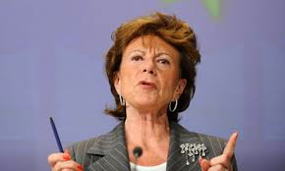
International context
In 2013, Neelie Kroes, Vice-President of the European Commission responsible for the Digital Agenda, declared, “... taxpayers who are paying for that research will want to see something back. ... That's why we will require open access to all publications stemming from EU-funded research. That's why we will progressively open access to the research data, too. And why we're asking national funding bodies to do the same.”
Opening Up Scientific Data , speech by Nellie Kroes given at the Launch of the Research Data Alliance/Stockholm, 18 March 2013 http://europa.eu/rapid/press-release_SPEECH-13-236_en.htm

Slide 24
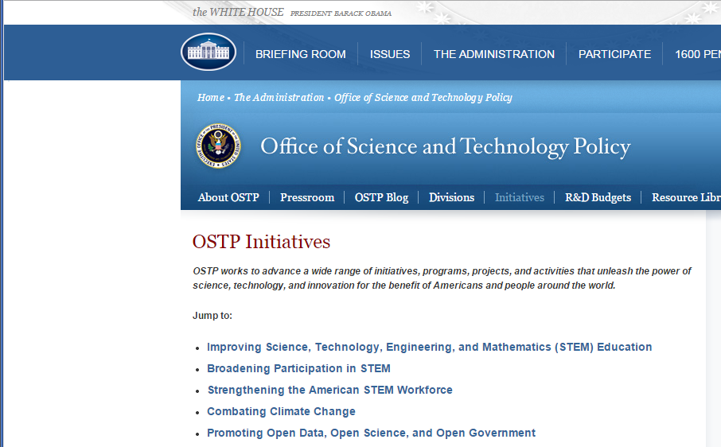
Notes:
“Government information shall be managed as an asset throughout its life cycle to promote interoperability and openness, and, wherever possible and legally permissible, to ensure that data are released to the public in ways that make the data easy to find, accessible, and usable.”

Slide 25

G8 Science Ministers Statement
“To the greatest extent and with the fewest constraints possible publicly funded scientific research data should be open, while at the same time respecting concerns in relation to privacy, safety, security and commercial interests, whilst acknowledging the legitimate concerns of private partners.”
13 June 2013

Slide 26
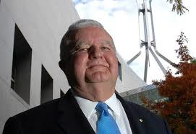
“The collaborative response to global challenges isn’t possible unless we get [research infrastructure] fundamentals right first, and one of those fundamentals is sharing high quality research data.”
keynote speech at the Research Data Alliance Third Plenary in Dublin on 26 March 2014
Notes:
Australia also recognizes this

Slide 27

USA
The NSF requires that, in an application for funding, Senior personnel should include: A list of: (i) up to five products most closely related to the proposed project; and (ii) up to five other significant products, whether or not related to the proposed project. Acceptable products must be citable and accessible including but not limited to publications, data sets, software, patents, and copyrights.
See http://www.nsf.gov/pubs/policydocs/pappguide/nsf13001/gpg_2.jsp#IIC2fic

Slide 28


  Open Data Trial with about 20% of EU-funded projects 2013-14
  In specific areas:
    technology; climate; energy; society & science (opt out)
    Opt in from other areas
  Data publishing was required
Notes:
1824 projects were trialled on an opt-in basis
Exceptions (Defence etc) were allowed
442 dropped out and 334 more opted in (from outside the trial)
Repository provided
Funding provided
Positively reviewed and now being implemented in same ‘classes’ (categories) of funding

Slide 29

ARC Application Requirements
Management of Data (Project Description)
“Outline plans for the management of data produced as a result of the proposed research, including but not limited to storage, access and re-use arrangements”*.
“The Final Report must outline how data arising from the Project have been made publicly accessible where appropriate.”**
* ARC Discovery Program Application Form
** ARC Discovery Program Funding Agreement

Slide 30

Implementation

Slide 31

Research Publications
Repositories Survey
The need for integration of data management and RPR systems is increasingly recognised
Increase in the number of institutions reporting integration of the workflows in the RPR and the data management system (less than 10% in 2012 to more than 60% in 2014).
Over half of the institutions say that they are now providing a data storage service.
http://www.caul.edu.au/content/upload/files/surveys/repositories2014public.pdf

Slide 32

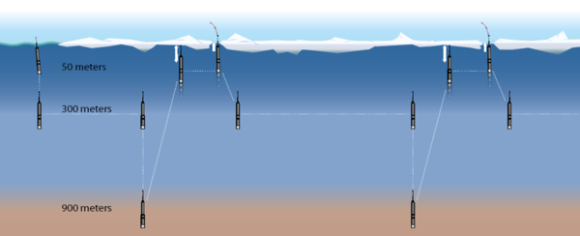
NCRIS Open Data
Data-intensive facilities in marine, astronomy, terrestrial ecosystems, earth sciences, bidodiversity, etc
Data storage, mgmt, and publication infrastructure
High performance computing data centre

Slide 33

Institutional Motivation
Compliance
Integrity of research
Research quality/ impact
Profile

Slide 34
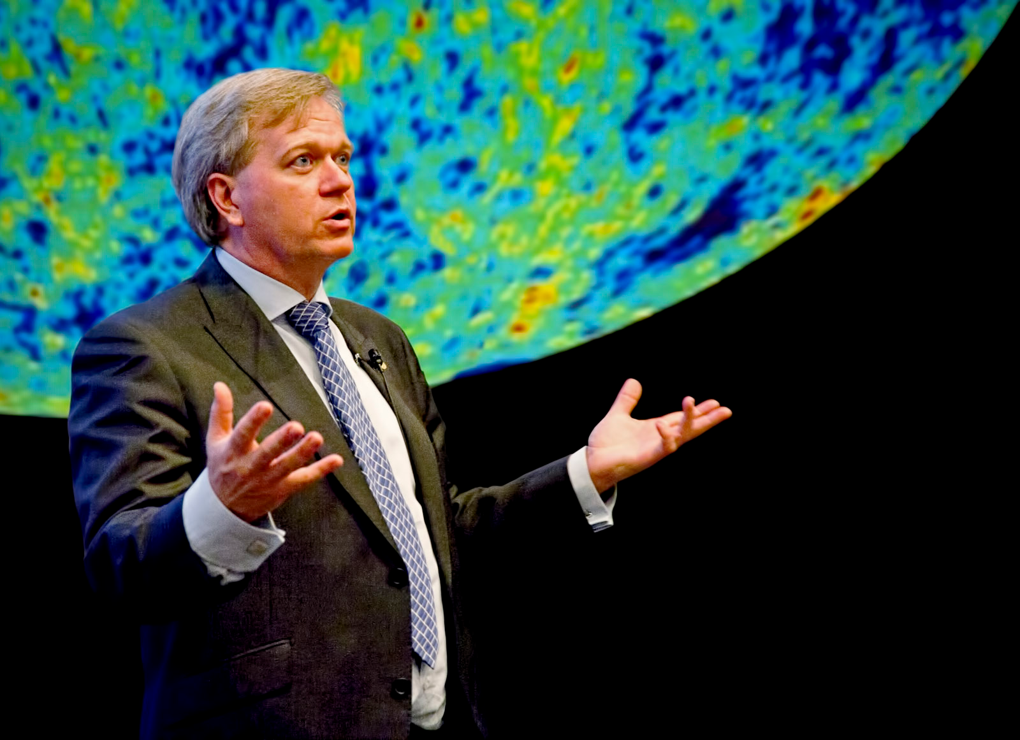
Researcher Motivation
Collaboration
Citation/ impact
Research integrity
Journal policy
Profile
Legacy

Slide 35
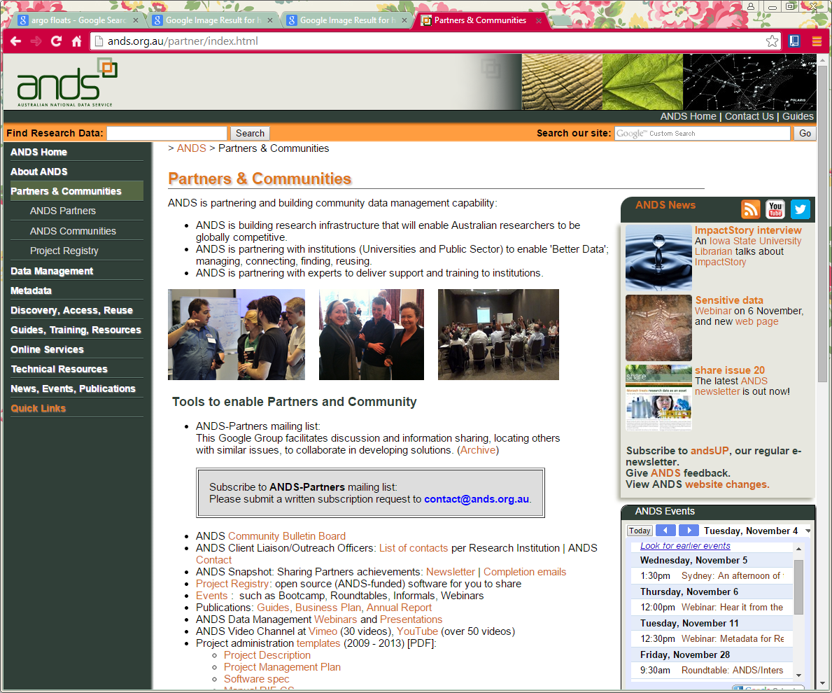

Slide 36
Panel Members
Professor Andrew Heathcote – Newcastle Uni
Dr Gillian Lawson – QUT
A/ Professor Katrina Schlunke – UTS
Professor Laurie Buys - QUT
A/ Professor Stephan Chalup – Newcastle Uni
Facilitator: Roxanne Missingham - ANU

Slide 37
Thank you
Emeritus Professor Tom Cochrane
Dr Erin McKiernan
Dr Adrian Burton
Professor Andrew Heathcote
Dr Gillian Lawson
A/ Professor Katrina Schlunke
Professor Laurie Buys - QUT
A/ Professor Stephan Chalup

Slide 38
Stay connected
Sign up for our fortnightly newsletter www.aoasg.org.au
Follow us on Twitter @openaccess_oz
Sign our Open Access Supporters page:
http://aoasg.org.au/support-for-open-access/

